Slide 1

Louisiana
2009 Traffic Records
Data Report
lhsc.lsu.edu
Lacrashdata.lsu.edu
Presented by Dr. Helmut Schneider

Slide 2
Summary of the 2009 LOUISIANA TRAFFIC RECORDS DATA REPORT
  729 fatal crashes
  824 fatalities
  73,856 injuries
  109,793 property-damage-only crashes

Slide 3
Cost Comparison
2009
2008
$5.69* billion dollars to the citizens of Louisiana
$1,991 for every licensed driver in Louisiana
$6.34* billion dollars to the citizens of Louisiana
$2,233 for every licensed driver in Louisiana
$242 in savings per year for every licensed driver.
Notes:
$230 Billion in 2000 which is about $280 billion in 2008 dollars.

Slide 4
2008-2009 Comparison
2009-2008
2008-2007
In 2009 there were 824 persons killed which decreased by 9.9% from 2008.
In 200 there were 729 fatal crashes which decreased by 11.1% from 2008.
In 2009 there were 1096 vehicles involved in fatal crashes which decreased by 9.8% from 2008.
In 2009, Louisiana had 556 drivers killed in fatal crashes which decreased by 6.6% from 2008
In 2009 there were 73,856 persons injured which decreased by 2.7% from 2008.
In 2009 there were 45,335 injury crashes which decreased by 2.5% from 2008.
In 2008 there were 915 persons killed which decreased by 8.2% from 2007.
In 2008 there were 820 fatal crashes which decreased by 9.2% from 2007.
In 2008 there were 1215 vehicles involved in fatal crashes which decreased by 11.2% from 2007.
In 2008, Louisiana had 595 drivers killed in fatal crashes which decreased by 10.4% from 2007.
In 2008 there were 75,883 persons injured which decreased by 3.8% from 2007
In 2008 there were 46,487 injury crashes which decreased by 3.5% from 2007

Slide 5
  Louisiana's 2009 Fatality Rates
2009-2008
2008-2007
1.84 deaths per 100 million miles traveled which decreased by 9.75% from 2008.
19.19 deaths per 100,000 population which decreased by 9.95% from 2008.
28.81 deaths per 100,000 licensed drivers which decreased by 10.21% from 2008.
2.0 deaths per 100 million miles traveled which decreased by 7.4% from 2007.
21.3 deaths per 100,000 population which decreased by 8.1% from 2007.
32 deaths per 100,000 licensed drivers which decreased by 8.5% from 2007.

Slide 6
Louisiana's 2009 injury rates
2009-2008
2008-2007
164.6 injuries per 100 million miles traveled which decreased by 2.5% from 2008
1,720 per 100,000 population which decreased by 3% from 2008.
2,583 injuries per 100,000 licensed drivers which decreased by 3% from 2008.
168 injuries per 100 million miles traveled which decreased by 3.2% from 2007.
1,768 per 100,000 population which decreased by 3.8% from 2007.
2,661 injuries per 100,000 licensed drivers which decreased by 4.3% from 2007.

Slide 7
Fatalities and Fatal Crashes have declined significantly in 2009 for the second year in a row

Slide 8
Fatalities per 1,000 Crashes

Slide 9
Fatalities per 100 Million Miles
Notes:
Louisiana is more rural than the average state

Slide 10
Injuries per 1,000 Crashes

Slide 11
Injuries per 100 Million Miles

Slide 12
Average Decline from 2008 to 2009 and 2007 to 2009
Overall fatalities decreased by
  9.9% from 2008 and
  17% from 2007
Fatal crashes decreased by
  11.1% from 2008 and
  19% from 2007

Slide 13
2010 Predictions
The fatalities in 2010 are predicted to continue to decline slightly.

Slide 14
Fatal Crash Rate of Youths Drivers Declined

Slide 15
Injury Crash Rate of Youths Drivers Declined

Slide 16
Parish Size and Decline of Fatal Crashes
Licensed Drivers | 2009-2008 |  | 2008-2007 |  | 2009-2007
 | % | Diff | % | Diff | % | Diff
100,000+ | -5% | -11 | -14% | -42 | -16% | -53
50,000-100,000 | -16% | -31 | 3% | 0 | -13% | -31
20,000-50,000 | -14% | -33 | -8% | -4 | -18% | -37
10,000-20,000 | -13% | -8 | -10% | -9 | -13% | -17
<10,000 | -12% | -8 | -24% | -23 | -38% | -31

Slide 17
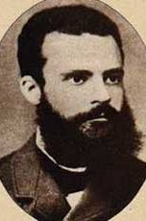
Pareto: The 20-80 Rule
80% of the Problems come from
20% of the Causes
Separate the Vital Few from the
Trivial Many
Vilfredo Pareto, 1848-1923

Slide 18
Over 84% of driver fatalities involved one of these three factors of the driver killed.
Lack of Seatbelt Use
Aggressive
Driving
Alcohol
58%
72%
78%
19%
52%
48%
72%
Notes:
driver 378 alcohol 187- 49%
no seatbelt 222- 59%
Aggress dr 204 -54%
any of three 323- 85%
all three 82- 22%
--all drivers
select count(*) as anythree
from vehic_tb
where veh_type_cd in ('a','b','c','d')
and dr_inj_cd='a'
--alcohol
select count(*) as alcohol
from vehic_tb
where veh_type_cd in ('a','b','c','d')
and dr_inj_cd='a'
and vehic_tb.est_alcohol='1'
--seatbelt
select count(*) as seatbelt
from vehic_tb
where veh_type_cd in ('a','b','c','d')
and dr_inj_cd='a'
and DR_PROTSYS_CD ='a'
---aggressive dr
select count(*) as aggressive
from vehic_tb
where veh_type_cd in ('a','b','c','d')
and dr_inj_cd='a'
and VIOLATIONS_CD IN ('S','C','L','D','B','A','F')
---alco&seatbelt
select count(*) as alc_seatb
from vehic_tb
where veh_type_cd in ('a','b','c','d')
and dr_inj_cd='a'
and (vehic_tb.est_alcohol='1'
or DR_PROTSYS_CD ='a' )
---all alc_viol
select count(*) as alc_viol
from vehic_tb
where veh_type_cd in ('a','b','c','d')
and dr_inj_cd='a'
and (vehic_tb.est_alcohol='1'
or VIOLATIONS_CD IN ('S','C','L','D','B','A','F'))
---all seatb_viol
select count(*) as sb_viol
from vehic_tb
where veh_type_cd in ('a','b','c','d')
and dr_inj_cd='a'
and (DR_PROTSYS_CD ='a'
or VIOLATIONS_CD IN ('S','C','L','D','B','A','F'))
---all three
select count(*) as allthree
from vehic_tb
where veh_type_cd in ('a','b','c','d')
and dr_inj_cd='a'
and (vehic_tb.est_alcohol='1'
and DR_PROTSYS_CD ='a'
and VIOLATIONS_CD IN ('S','C','L','D','B','A','F'))
---any three
select count(*) as anythree
from vehic_tb
where veh_type_cd in ('a','b','c','d')
and dr_inj_cd='a'
and (vehic_tb.est_alcohol='1'
or DR_PROTSYS_CD ='a'
or VIOLATIONS_CD IN ('S','C','L','D','B','A','F'))

Slide 19
Alcohol & Crashes
In 2009, 353 fatal crashes with 402 fatalities were estimated to be alcohol related which decreased by 11.5% and 10.9%, respectively from 2008.
In 2009, 4,111 injury crashes ( 9.1% ) were estimated to be alcohol related which decreased by 3.8% from 2008.
In 2008, 4745 PDO crashes ( 4.3% ) were estimated to be alcohol related which decreased by .1% from 2008.
However, the percentage of alcohol related crashes in 2009 dropped from 49% in 2008 to 48% in 2009.
Notes:
Need 2009 cost

Slide 20
Alcohol-Related Fatalities have decreased since 2007.

Slide 21
Percentage Alcohol-Related Fatalities have been steady at 49% over the past three years…

Slide 22
...and BAC levels have been increasing but….

Slide 23
...this may be due to better reporting
Notes:
Due to an increased reporting BAC levels are increasing.

Slide 24
Trend in youth alcohol-related fatal crashes shows a steady decline over the past two years

Slide 25
Reflections How to Reduce Alcohol-related Crashes
Year-to year data exhibit large variations
Designed studies are helpful to block out variation

Slide 26
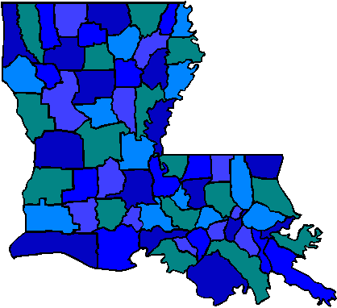
Target of Opportunity Designed Study
Findings from 2001
The “Targets of Opportunity” project was successful
  Alcohol-related fatalities were reduced by 14.8% in 16 parishes
  The percentage of alcohol-related fatalities were reduced
    by 5 percentage points in the 16 parishes (47.6%-42.3%)
  49 lives were saved in the first 12 months of the project.
  For every 1,000 hours of saturation patrol 4 lives are saved.
  For every 100 SFST 3 lives are saved.

Slide 27
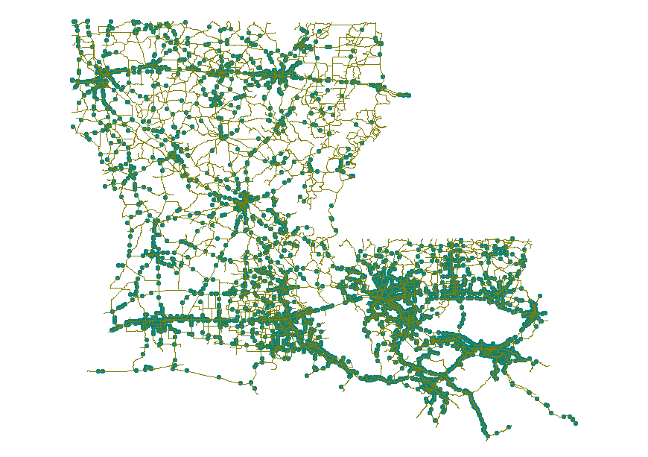
Findings
Of the Target of Opportunities Project from 2001
  Enforcement is essential
  South versus north Louisiana
  Casual versus heavy drinkers (97% of DUI in fatal crashes are without arrest in the past 3 years)
  Youth (<24) versus adult drivers : Youth drivers respond more to enforcement
  Evening versus late night-early morning: Early evening returning drivers respond more to enforcement
  Repeat offenders respond less to enforcement
Notes:
While the “Target of Opportunity Study” had an overall effect in reducing alcohol-related fatalities by 5 percentage points, there were many factors that influenced the magnitude of the effect and were responsible for the effect not being statistically significant. The effect could have been as high as 20% if the treatment would have been more uniformly applied in all parishes. The effect was likely stronger for non-heavy drinkers, i.e. BAC below the legal limit than for heavy drinkers with high BAC levels. This indicates that heavy drinkers are less likely to be influenced by enforcement and public awareness campaigns than drivers who drink less alcohol to begin with. South Louisiana where drinking is more popular had smaller effect than north Louisiana where drinking is less popular. Younger drivers (<24) are more receptive to enforcement than older drivers. Drivers returning home late evening and early morning hours 11pm-3am are less likely to be affected by increased enforcement.
All studies are faced with spurious factors that confound the experiment and lead to variations in the treatment effect and bias. Thus, it is important to carefully plan an experiment, have controls and randomize if possible. After the experiment has been conducted carful analysis of extraneous factors should be conducted.

Slide 28
2009-2008 DWI Arrests
2008
2009
24,736 Arrests
22,478 Adult DWI Arrest
7,947 Refusals
1,637 Age 15-20 DWI
31,970 Arrests
29,164 Adult DWI Arrest
8,858 Refusals
2,806 Age 15-20 DWI

Slide 29
DWI Arrests by Troop
Troop | Arrests 2009 | Arrests 2008 | % Change arrests
A | 2186 | 1685 | 30%
B | 1672 | 990 | 69%
C | 1546 | 892 | 73%
D | 1413 | 871 | 62%
E | 1022 | 771 | 33%
F | 1015 | 796 | 28%
G | 1072 | 1119 | -4%
I | 1895 | 1333 | 42%
L | 2304 | 2158 | 7%
Total LA | 31639 | 24450 | 29%

Slide 30
Using Bayes Theorem to Profile of DUI Drivers
What is the probability that a fatal crash happening between 12 am and 3 am with a male driver age 18-25 is alcohol-related?
Notes:
In further reviewing the crash we notice that the crash happened between 12 am and 3 am involved a male driver age between 18-25? Now, what is the revised probability for the crash to be alcohol-related.

Slide 31
Using Bayes Theorem to Profile of DUI Drivers
What is the probability that a fatal crash happening between 12 am and 3 am with a male driver age 18-25 is alcohol-related?
Answer: 85%
Notes:
In further reviewing the crash we notice that the crash happened between 12 am and 3 am involved a male driver age between 18-25? Now, what is the revised probability for the crash to be alcohol-related. There are 34 out of 729 fatal crashes between 1-3 am that involved a male driver age 18-25, that is 4.7%. Also, there were 30 out of the 354 fatal alcohol-related crashes that occurred between 1-3 am that involved a male driver age 18-25 that is 8.5%. Thus P(A|B)=0.085*0.49/0.047.=0.85. Thus, the chance for this crash to be alcohol-related increased to 89% based on the new information.
The Bayes Theorem is the basis for the algorithm the HSRG uses to estimate if a crash was alcohol related in cases the information about BAC test is not available. In general, the Bayes Theorem allows us to revise our assessment of the chances for an event based on additional information.

Slide 32
Using Bayes Theorem to Profile of DUI Drivers
What is the probability that a fatal crash happening between 12 am and 3 am with a male driver age 18-25 not wearing a seat belt is alcohol-related?
Notes:
select count(*)
from crash_tb inner join vehic_tb on crash_tb.crash_num=vehic_tb.crash_num
where severity_cd='a' and dr_age between 18 and 25 and cr_hour between 1 and 3 and dr_sex='m' and DR_PROTSYS_CD='a'
select count(*)
from crash_tb inner join vehic_tb on crash_tb.crash_num=vehic_tb.crash_num
where severity_cd='a' and dr_age between 18 and 25 and cr_hour between 1 and 3 and dr_sex='m' and vehic_tb.est_alcohol=1
and DR_PROTSYS_CD='a'
select count(*)
from crash_tb inner join vehic_tb on crash_tb.crash_num=vehic_tb.crash_num
where severity_cd='a' and dr_age between 18 and 25 and cr_hour between 1 and 3 and dr_sex='m' and vehic_tb.est_alcohol=1

Slide 33
Using Bayes Theorem to Profile of DUI Drivers
What is the probability that a fatal crash happening between 12 am and 3 am with a male driver age 18-25 not wearing a seat belt is alcohol-related?
Answer: 95%
Notes:
In further reviewing the crash we notice that the crash happened between 12 am and 3 am involved a male driver age between 18-25? Now, what is the revised probability for the crash to be alcohol-related. There are 15 out of 729 fatal crashes between 1-3 am that involved a male driver age 18-25 not wearing a seat belt , that is 2.06%. Also, there were 14 out of the 353 fatal alcohol-related crashes that occurred between 1-3 am that involved a male driver age 18-25 not wearing a seat belt that is 4%. Thus P(A|B)=0.021*0.49/0.04.=0.95. Thus, the chance for this crash to be alcohol-related increased to 89% based on the new information.
The Bayes Theorem is the basis for the algorithm the HSRG uses to estimate if a crash was alcohol related in cases the information about BAC test is not available. In general, the Bayes Theorem allows us to revise our assessment of the chances for an event based on additional information.
select count(*)
from crash_tb inner join vehic_tb on crash_tb.crash_num=vehic_tb.crash_num
where severity_cd='a' and dr_age between 18 and 25 and cr_hour between 1 and 3 and dr_sex='m' and DR_PROTSYS_CD='a'
select count(*)
from crash_tb inner join vehic_tb on crash_tb.crash_num=vehic_tb.crash_num
where severity_cd='a' and dr_age between 18 and 25 and cr_hour between 1 and 3 and dr_sex='m' and vehic_tb.est_alcohol=1
and DR_PROTSYS_CD='a'
select count(*)
from crash_tb inner join vehic_tb on crash_tb.crash_num=vehic_tb.crash_num
where severity_cd='a' and dr_age between 18 and 25 and cr_hour between 1 and 3 and dr_sex='m' and vehic_tb.est_alcohol=1

Slide 34
Using Bayes Theorem to Profile of DUI Drivers
What is the probability that a fatal crash happening between 12 am and 3 am with a driver not wearing a seat belt is alcohol-related?
Notes:
In further reviewing the crash we notice that the crash happened between 12 am and 3 am involved a male driver age between 18-25? Now, what is the revised probability for the crash to be alcohol-related. There are 15 out of 729 fatal crashes between 1-3 am that involved a male driver age 18-25 not wearing a seat belt , that is 2.06%. Also, there were 14 out of the 353 fatal alcohol-related crashes that occurred between 1-3 am that involved a male driver age 18-25 not wearing a seat belt that is 4%. Thus P(A|B)=0.021*0.49/0.04.=0.95. Thus, the chance for this crash to be alcohol-related increased to 89% based on the new information.
The Bayes Theorem is the basis for the algorithm the HSRG uses to estimate if a crash was alcohol related in cases the information about BAC test is not available. In general, the Bayes Theorem allows us to revise our assessment of the chances for an event based on additional information.
select count(*)
from crash_tb inner join vehic_tb on crash_tb.crash_num=vehic_tb.crash_num
where severity_cd='a' and dr_age between 18 and 25 and cr_hour between 1 and 3 and dr_sex='m' and DR_PROTSYS_CD='a'
select count(*)
from crash_tb inner join vehic_tb on crash_tb.crash_num=vehic_tb.crash_num
where severity_cd='a' and dr_age between 18 and 25 and cr_hour between 1 and 3 and dr_sex='m' and vehic_tb.est_alcohol=1
and DR_PROTSYS_CD='a'
select count(*)
from crash_tb inner join vehic_tb on crash_tb.crash_num=vehic_tb.crash_num
where severity_cd='a' and dr_age between 18 and 25 and cr_hour between 1 and 3 and dr_sex='m' and vehic_tb.est_alcohol=1

Slide 35
Using Bayes Theorem to Profile of DUI Drivers
What is the probability that a fatal crash happening between 12 am and 3 am with a driver not wearing a seat belt is alcohol-related?
Answer: 83%
Notes:
In further reviewing the crash we notice that the crash happened between 12 am and 3 am involved a male driver age between 18-25? Now, what is the revised probability for the crash to be alcohol-related. There are 15 out of 729 fatal crashes between 1-3 am that involved a male driver age 18-25 not wearing a seat belt , that is 2.06%. Also, there were 14 out of the 353 fatal alcohol-related crashes that occurred between 1-3 am that involved a male driver age 18-25 not wearing a seat belt that is 4%. Thus P(A|B)=0.021*0.49/0.04.=0.95. Thus, the chance for this crash to be alcohol-related increased to 89% based on the new information.
The Bayes Theorem is the basis for the algorithm the HSRG uses to estimate if a crash was alcohol related in cases the information about BAC test is not available. In general, the Bayes Theorem allows us to revise our assessment of the chances for an event based on additional information.
select count(*)
from crash_tb inner join vehic_tb on crash_tb.crash_num=vehic_tb.crash_num
where severity_cd='a' and dr_age between 18 and 25 and cr_hour between 1 and 3 and dr_sex='m' and DR_PROTSYS_CD='a'
select count(*)
from crash_tb inner join vehic_tb on crash_tb.crash_num=vehic_tb.crash_num
where severity_cd='a' and dr_age between 18 and 25 and cr_hour between 1 and 3 and dr_sex='m' and vehic_tb.est_alcohol=1
and DR_PROTSYS_CD='a'
select count(*)
from crash_tb inner join vehic_tb on crash_tb.crash_num=vehic_tb.crash_num
where severity_cd='a' and dr_age between 18 and 25 and cr_hour between 1 and 3 and dr_sex='m' and vehic_tb.est_alcohol=1

Slide 36
Male versus Female
Drivers in alcohol-related crashes are still predominantly male

Slide 37
Alcohol, Seat Belt and Gender
Not wearing a seat belt at night is an indicator of driving under the influence
Drivers in alcohol-related fatal crashes are likely to be male
Night time seat-belt enforcement is an effective way to reduce DUIs

Slide 38
Commercial Vehicle Crashes

Slide 39
CMV
 | Year | 2005 | 2006 | 2007 | 2008 | 2009 | 1-Year % Change | 5-Year % Change
CMV Crashes | Fatal | 134 | 105 | 118 | 102 | 74 | -27% | -45%
 | Injury | 2197 | 1922 | 2120 | 1950 | 1596 | -18% | -27%
 | PDO | 2171 | 2093 | 2110 | 2115 | 1816 | -14% | -16%
 | Total CMV | 4502 | 4120 | 4348 | 4167 | 3486 | -16% | -23%
% CMV | Fatal | 12% | 12% | 13% | 12% | 10% | -2.2% | -1.9%
 | Injury | 4.4% | 3.9% | 4.4% | 4.2% | 3.6% | -0.6% | -0.8%
 | PDO | 2.0% | 1.9% | 1.9% | 1.9% | 1.7% | -0.2% | -0.3%
 | Total | 2.8% | 2.5% | 2.7% | 2.6% | 2.3% | -0.3% | -0.5%

Slide 40
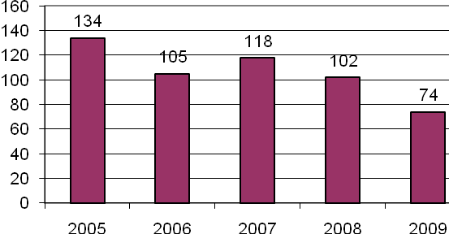
Fatal CMV Crashes were close to cut in half over the past 5 years

Slide 41
Violations as % of Drivers
 | FATAL CRASHES |  | TOTAL CRASHES
Year | Truck Driver | Passenger Car Driver | Truck Driver | Passenger Car Driver
2004 | 34% | 54% | 52% | 52%
2005 | 31% | 47% | 49% | 47%
2006 | 32% | 66% | 49% | 52%
2007 | 35% | 68% | 47% | 54%
2008 | 32% | 78% | 48% | 53%
2009 | 27% | 66% | 49% | 51%

Slide 42
Percentage of Violations of Truck versus other Car Driver
 | FATAL CRASHES |  | TOTAL CRASHES
Year | Truck Driver | Passenger Car Driver | Truck Driver | Passenger Car Driver
2004 | 36% | 64% | 54% | 46%
2005 | 37% | 63% | 39% | 61%
2006 | 30% | 70% | 51% | 49%
2007 | 38% | 62% | 50% | 50%
2008 | 33% | 67% | 50% | 50%
2009 | 29% | 71% | 51% | 49%

Slide 43
Manner of Collision in Fatal Crashes
CMV
All Crashes
Head on 26%
Rear end 27%
Right angle 19%
Non collision 7%
Head on 12%
Rear end 7%
Right angle 10%
Non collision 54%

Slide 44
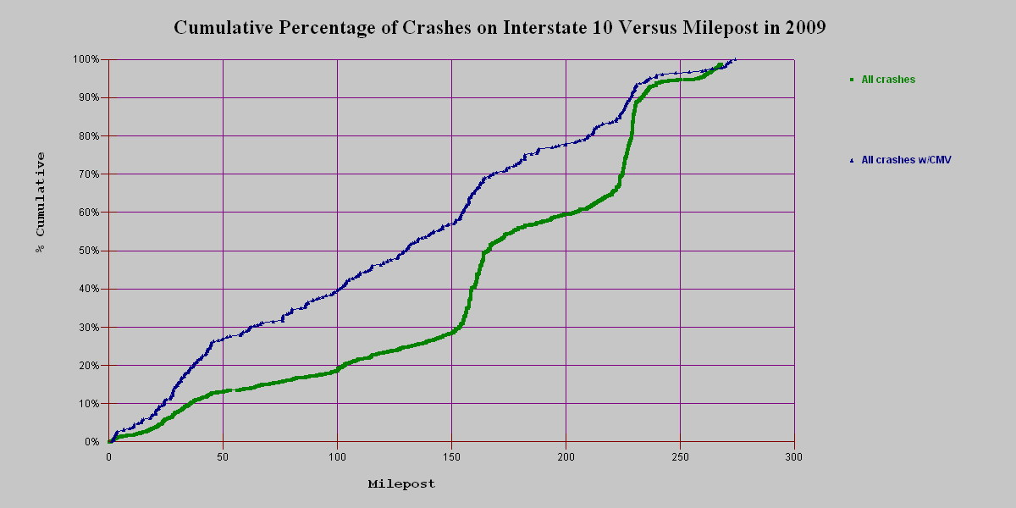
Interstate 10
While Interstate 10 has a high frequency of crashes at the I10/12 split, CMV crashes have a higher frequency within the first 10 miles of the Texas border.

Slide 45
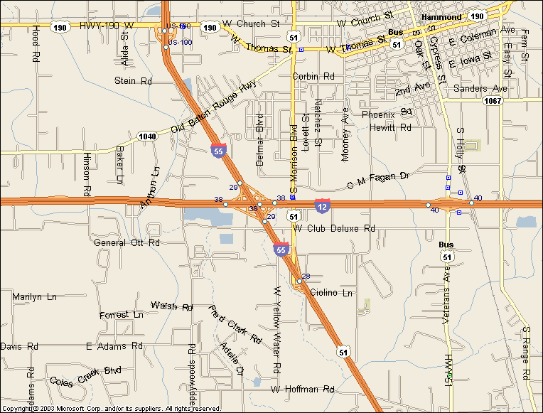
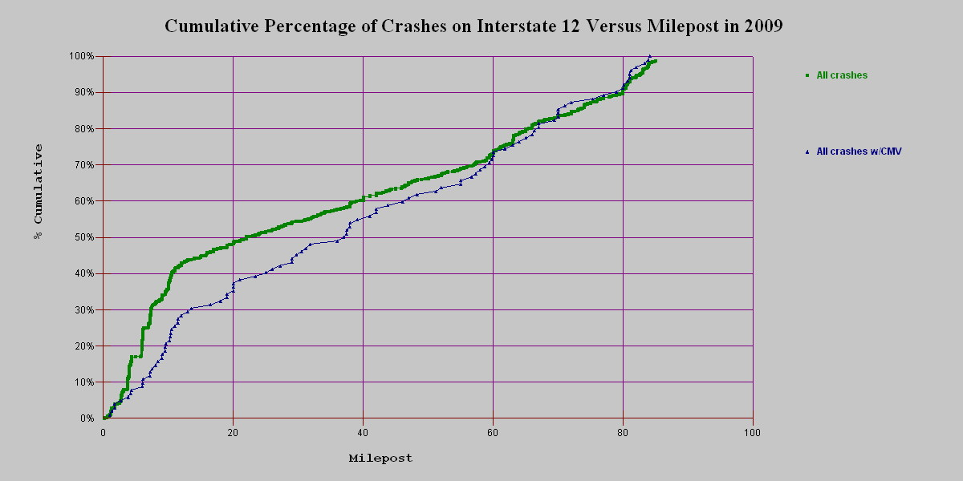
Interstate 12
I 12 has a relative high frequency of crashes for both CMV and non-CMV crashes within the first 10 miles.

Slide 46
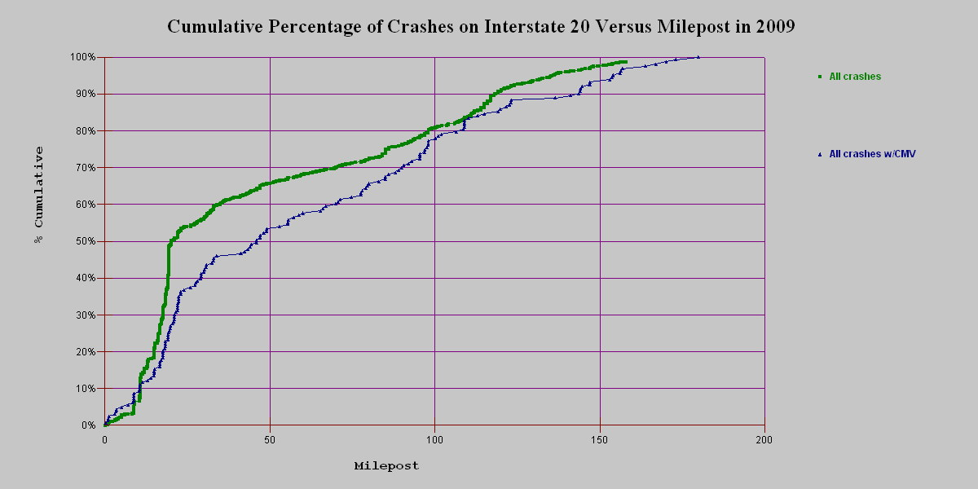
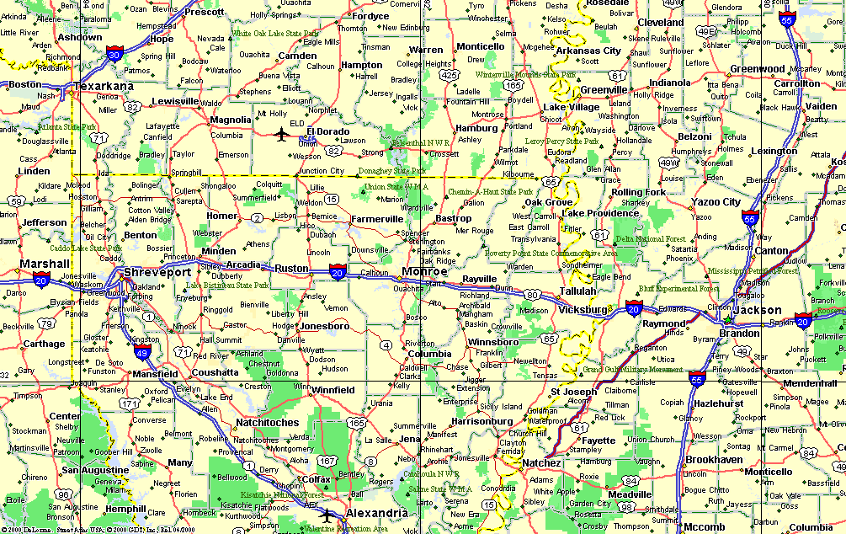
Interstate 20
The first 25 miles of interstate are clearly the trouble spots.

Slide 47
CMV Crashes in Construction Zones
 |  | 2009 |  |  |  | 2008
 |  | FATAL | INJURY | PDO | ALL | FATAL | INJURY | PDO | ALL
ALL CMV CRASHES ON INTERSTATES | Count | 22 | 350 | 503 | 875 | 26 | 476 | 631 | 1133
 | PER 100,000 Day-MILES | 6.7 | 107 | 154 | 268 | 8.0 | 146 | 193 | 347
CONSTRUCTION ZONES | Count | 10 | 90 | 131 | 231 | 6 | 121 | 132 | 259
 | PER 100,000 Day-MILES | 18.7 | 168 | 244 | 431 | 14.7 | 297 | 324 | 636
WITHIN 5 MILES OF CONSTRUCTION ZONES | Count | 18 | 193 | 263 | 474 | 14 | 255 | 298 | 567
 | PER 100,000 Day-MILES | 10.9 | 117 | 159 | 287 | 10.6 | 194 | 226 | 430
IN 5 MILES OUTSIDE CONSTRUCTION ZONE | Count | 8 | 103 | 132 | 243 | 8 | 134 | 166 | 308
 | PER 100,000 Day-MILES | 7.2 | 92 | 118 | 218 | 8.8 | 147 | 182 | 338

Slide 48
Hazardous Materials
Year | Transport | Released | % Released
2002 | 96 | 19 | 20%
2003 | 82 | 13 | 16%
2004 | 58 | 15 | 26%
2005 | 86 | 15 | 17%
2006 | 102 | 19 | 19%
2007 | 127 | 20 | 16%
2008 | 94 | 16 | 17%
2009 | 102 | 19 | 19%

Slide 49
Bus Crashes

Slide 50
Train Crashes

Slide 51
Bicycle Crashes
Fatalities
Injuries

Slide 52
Business Intelligence
Objective
  Provide simple measures
  Provide measures that relate to specific efforts that are taken or can be taken
  Provide timely information

Slide 53
Fatalities by Troop
Troop | 2007 | 2008 | 2009 | Diff 2008-2009 | Diff 2007-2009 | % 2008-2009 | % 2007-2009
A (EBR) | 116 | 108 | 109 | 1 | -7 | 1% | -6%
B (NO) | 41 | 44 | 28 | -16 | -13 | -36% | -32%
C (Houma) | 58 | 61 | 55 | -6 | -3 | -10% | -5%
D (Lake Charles) | 42 | 57 | 29 | -28 | -13 | -49% | -31%
E (Alexandria) | 88 | 73 | 83 | 10 | -5 | 14% | -6%
F (Monroe) | 60 | 53 | 46 | -7 | -14 | -13% | -23%
G (Shreveport) | 48 | 41 | 30 | -11 | -18 | -27% | -38%
I (Lafayette) | 99 | 73 | 66 | -7 | -33 | -10% | -33%
L (Hammond) | 67 | 76 | 71 | -5 | 4 | -7% | 6%

Slide 54
Fatalities by Troop Including Local Roads
Troop | 2007 | 2008 | 2009 | Diff 2008-2009 | Diff 2007-2009 | % 2008-2009 | % 2007-2009
A (EBR) | 159 | 147 | 137 | -10 | -22 | -7% | -14%
B (NO) | 119 | 98 | 90 | -8 | -29 | -8% | -24%
C (Houma) | 54 | 66 | 51 | -15 | -3 | -23% | -6%
D (Lake Charles) | 71 | 81 | 55 | -26 | -16 | -32% | -23%
E (Alexandria) | 98 | 75 | 82 | 7 | -16 | 9% | -16%
F (Monroe) | 72 | 70 | 52 | -18 | -20 | -26% | -28%
G (Shreveport) | 93 | 80 | 69 | -11 | -24 | -14% | -26%
I (Lafayette) | 137 | 112 | 112 | 0 | -25 | 0% | -18%
L (Hammond) | 97 | 91 | 81 | -10 | -16 | -11% | -16%

Slide 55
Troop A (BR)
Fatalities
All Crashes

Slide 56
Troop B (New Orleans)
Fatalities
All Crashes
Notes:
Bring your passport and tell them that you had a La driver

Slide 57
Troop C (Houma)
Fatalities
All Crashes

Slide 58
Troop D (Lake Charles)
Fatalities
All Crashes

Slide 59
Troop E (Alexandria)
Fatalities
All Crashes

Slide 60
Troop F (Monroe)
Fatalities
All Crashes

Slide 61
Troop G (Shreveport)
Fatalities
All Crashes

Slide 62
Troop I (Lafayette)
Fatalities
All Crashes

Slide 63
Troop L (Hammond)
Fatalities
All Crashes

Slide 64
Occupant Protection
Seat Belts
Motorcycle Helmets

Slide 65
Occupant protection
Seatbelt Use
Killed Occupants
75% of front-seat passengers were wearing a seat belt.
Thus the 25% of occupants who are not wearing a seat belt make up 65% of fatalities.
63% of drivers killed were reported not wearing a safety belt.
73% of passengers (5 years and older) killed were not wearing a safety belt.

Slide 66
While safety belt use has not changed much over the past six years…

Slide 67
… the percent of occupants killed not wearing a safety belt is still over 60%...

Slide 68
Percent of Fatalities Not Wearing Seat Belt/Harness by Age
2008
2009

Slide 69
Motorcycle Fatalities
There were 104 motorcycle fatalities in 2009 which increased by 28.4% from 2008.
There were 4.7 deaths of motorcycle drivers per 100 motorcycles in crashes for 2009 as compared to 3.4 in 2008.
Alcohol-related fatalities increased by 48%.
41% of fatal motorcycle crashes in 2009 involved alcohol up from 36% in 2008

Slide 70
Helmet Use
Helmet use in motorcycle crashes was 89% in 2009 as compared to 88% in 2008.
84% of motorcycle riders killed were known to have worn a helmet.
Properly used helmets in fatal crashes was only 79%.

Slide 71
Number of Motorcycle Riders Killed in Crashes in Louisiana 1999-2009
Motorcycle Fatalities
Number of Motorcycle in Crashes

Slide 72
Percent of Fatalities by Alcohol and
Helmet Use
Alcohol is a much larger contributing factor to the death rate than wearing a helmet (20% versus 3.0%).
4.1%

Slide 73
Single Vehicle Fatal Run-off-Road Crashes
Notes:
The single vehicle crashes have increased after 2004.

Slide 74
Aggressive Driving
Exceeding Stated Speed
Exceeding Save Speed
Failure to Yield
Following too closely
Driving left of center
Cutting in & Improper Passing
Disregard Traffic control
Careless Operation

Slide 75
Percent of Drivers in Fatal and Injury Crashes for Aggressive Driving
Type | Fatal | Injury | All | % Fatal | % Injury
Exceed Stated Speed | 35 | 233 | 553 | 5% | 1%
Exceed Safe Speed | 18 | 400 | 1105 | 3% | 1%
Failure to Yield | 59 | 8868 | 26939 | 8% | 20%
Following too Closely | 2 | 5921 | 22300 | 0% | 13%
Driving left of center | 63 | 562 | 1797 | 9% | 1%
Cutting in/Improper Passing | 6 | 612 | 3058 | 1% | 1%
Disregard Traffic Control | 25 | 2413 | 5813 | 3% | 5%
Carless Operation | 252 | 15285 | 46280 | 35% | 34%

Slide 76
Cell Phone use and Texting and Driving

Slide 77
Cost of Crashes
Type | 2008 | 2009 | % Difference
Lack of Seat Belt | $1.28 Billion | $1.1 Billion | -13%
Alcohol | $1.3 Billion | $1.1 Billion | -13%
Total | $6.34 Billion | $5.7 Billion | -10%

