Slide 1

Louisiana
2008 Traffic Records
Data Report
lhsc.lsu.edu
Lacrashdata.lsu.edu
Presented by Dr. Helmut Schneider

Slide 2
Summary of the 2008 LOUISIANA TRAFFIC RECORDS DATA REPORT
818 fatal crashes
913 fatalities
75.9 thousand injuries
110.6 thousand property-damage-only crashes

Slide 3
Cost to Louisiana Citizens
$6.43 billion dollars to the citizens of Louisiana
$2,264 for every licensed driver in Louisiana
These costs are partly responsible for high auto Insurance premiums. For instance, in 2006 Louisiana
  Ranked first for auto insurance premium/income among the 50 states by NAIC
  Ranked third with respect to cost of auto insurance by NAIC
  Ranked consistently highest by www.insurance.com for the past three years
Cost for the Nation $280 Billion per year.
Notes:
$230 Billion in 2000 which is about $280 billion in 2008 dollars.

Slide 4
Cost Distribution
Louisiana Specifics
National Cost Distribution
Law Suits
  15%-19% in Louisiana
  3%-5% in Texas and Mississippi
  24-32% claims in suit to open claims in Louisiana
  5-10% in Texas and Mississippi
6% of uninjured occupants and 50% of occupants with complaints were transported to hospitals by EMS

Slide 5
2007-2008 Comparison
In 2008 there were 913 persons killed which decreased by 8.2% from 2007.
In 2008 there were 817 fatal crashes which decreased by 9.2% from 2007.
In 2008 there were 1212 vehicles involved in fatal crashes which decreased by 11.2% from 2007.
In 2008, Louisiana had 593 drivers killed in fatal crashes which decreased by 10.4% from 2007.
In 2008 there were 75,883 persons injured which decreased by 3.8% from 2007
In 2008 there were 46,487 injury crashes which decreased by 3.5% from 2007

Slide 6
  Louisiana's 2008 Fatality Rates
  VMT declined by 1%
2.0 deaths per 100 million miles traveled which decreased by 7.4% from 2007.
21.3 deaths per 100,000 population which decreased by 8.1% from 2007.
32 deaths per 100,000 licensed drivers which decreased by 8.5% from 2007.

Slide 7
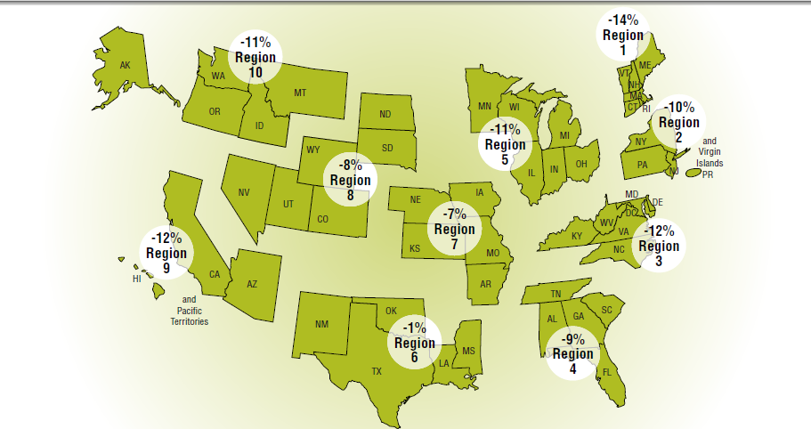
National Comparison

Slide 8
Louisiana's 2008 injury rates
168 injuries per 100 million miles traveled which decreased by 3.2% from 2007.
1768 per 100,000 population which decreased by 3.8% from 2007.
2661 injuries per 100,000 licensed drivers which decreased by 4.3% from 2007.

Slide 9
Fatalities and Fatal Crashes have declined significantly in 2008 for the first time in 5 years

Slide 10
Fatalities per 1,000 Crashes

Slide 11
Fatalities per 100 Million Miles
Notes:
Louisiana is more rural than the average state

Slide 12
Injuries per 1,000 Crashes

Slide 13
Injuries per 100 Million Miles

Slide 14
Average Decline from 2007 to 2008 is about 8% to 9%
Overall fatalities decreased by 8.2%
Fatal crashes decreased by 9.2%
Alcohol related fatalities decreased by 7.8%

Slide 15
Where do we see the largest decline in fatalities from
2007 to 2008?

Slide 16
1. Rural Areas
Rural Parishes with less than 10,000 licensed drivers had a decline of 38% in fatalities.

Slide 17
2. Youths
Crash rate of drivers of ages 18-20 in fatal crashes declined by 34%.
18-20 year old drivers made up 7.2% of all drivers in fatal crashes in 2008 versus 9.8 in 2007.
A decline of drivers ages 18-20 in alcohol related crashes from 12% in 2007 to 8% in 2008.

Slide 18
The Crash Rate of 18-20-year-old drivers has declined

Slide 19
3. Female Drivers
Female driver fatalities declined by 20%
A decline of 13% in female drivers involved in crashes versus 7% for males

Slide 20
4. Pickup Trucks
Pickup trucks had a decline of 19% in fatal crashes

Slide 21
5. Interstates
The interstate fatal crashes decreased by 17% from 2007 to 2008.
  The number of fatalities per 100 million miles traveled was 1.1 in 2008 compared to 2 for Louisiana as a whole.

Slide 22
6. Summer Months
All Crashes by Month
Fatal Crashes by Month
Notes:
May and June had 56 and 57% alcohol related fatalities respectively. In June 20 (1 out of 5) were drivers ages 15-20 which are fewer that 8% of licensed drivers.

Slide 23
Forecast for 2009 and 2010
Notes:
Hypothesis: there are two distinct patterns: Summer October-March and April to September.
Summer months have more leisure driving affected by gas prices and the economy such available income (unemployment).
Since half of the crashes are alcohol related fatalities correlate more with leisure driving than with overall VMT.
VMT declined by 1%.

Slide 24
Fatalities
Fall-Winter-Early Spring

Slide 25
Fatalities - Summer

Slide 26
Fatalities
Fall/Winter versus Summer

Slide 27
Observations
Although VMT was down by only 1%
Fatalities were down by 8.2%
Much of this decline may be due to reduced leisure driving which will continue through 2010 because of the state of the economy
The year 2009 may see a slight rise in fatalities compared to 2008

Slide 28
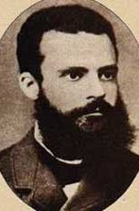
Pareto: The 20-80 Rule
80% of the Problems come from
20% of the Causes
Separate the Vital Few from the
Trivial Many
Vilfredo Pareto, 1848-1923

Slide 29
Over 85% of driver fatalities involve one of these three factors of the driver killed.
Lack of Seatbelt Use
Aggressive
Driving
Alcohol
59%
54%
49%
22%
Notes:
driver 378 alcohol 187- 49%
no seatbelt 222- 59%
Aggress dr 204 -54%
any of three 323- 85%
all three 82- 22%
--all drivers
select count(*) as anythree
from vehic_tb
where veh_type_cd in ('a','b','c','d')
and dr_inj_cd='a'
--alcohol
select count(*) as alcohol
from vehic_tb
where veh_type_cd in ('a','b','c','d')
and dr_inj_cd='a'
and vehic_tb.est_alcohol='1'
--seatbelt
select count(*) as seatbelt
from vehic_tb
where veh_type_cd in ('a','b','c','d')
and dr_inj_cd='a'
and DR_PROTSYS_CD ='a'
---aggressive dr
select count(*) as aggressive
from vehic_tb
where veh_type_cd in ('a','b','c','d')
and dr_inj_cd='a'
and VIOLATIONS_CD IN ('S','C','L','D','B','A','F')
---alco&seatbelt
select count(*) as alc_seatb
from vehic_tb
where veh_type_cd in ('a','b','c','d')
and dr_inj_cd='a'
and (vehic_tb.est_alcohol='1'
or DR_PROTSYS_CD ='a' )
---all alc_viol
select count(*) as alc_viol
from vehic_tb
where veh_type_cd in ('a','b','c','d')
and dr_inj_cd='a'
and (vehic_tb.est_alcohol='1'
or VIOLATIONS_CD IN ('S','C','L','D','B','A','F'))
---all seatb_viol
select count(*) as sb_viol
from vehic_tb
where veh_type_cd in ('a','b','c','d')
and dr_inj_cd='a'
and (DR_PROTSYS_CD ='a'
or VIOLATIONS_CD IN ('S','C','L','D','B','A','F'))
---all three
select count(*) as allthree
from vehic_tb
where veh_type_cd in ('a','b','c','d')
and dr_inj_cd='a'
and (vehic_tb.est_alcohol='1'
and DR_PROTSYS_CD ='a'
and VIOLATIONS_CD IN ('S','C','L','D','B','A','F'))
---any three
select count(*) as anythree
from vehic_tb
where veh_type_cd in ('a','b','c','d')
and dr_inj_cd='a'
and (vehic_tb.est_alcohol='1'
or DR_PROTSYS_CD ='a'
or VIOLATIONS_CD IN ('S','C','L','D','B','A','F'))

Slide 30
Alcohol & Crashes
In 2008, 398 fatal crashes with 449 fatalities were estimated to be alcohol related which decreased by 9.3% and 7.8%, respectively from 2007.
In 2008, 4266 injury crashes ( 9.2% ) were estimated to be alcohol related which decreased by 3.5% from 2007.
In 2008, 4742 PDO crashes ( 4.3% ) were estimated to be alcohol related which increased by 1.6% from 2007.
However, the percentage of alcohol related crashes in 2008 was (49%) (same as 2007).
Cost to the Louisiana Citizens $1.3 Billion, $454 per licensed driver.

Slide 31
Percentage of Alcohol-Related Fatalities have increased since 2006.

Slide 32
Trend in youth alcohol-related fatal crashes shows a steady decline for 15-17-year-old drivers and a one year decline for 18-20-year-old drivers

Slide 33
Alcohol-Crashes By Month

Slide 34
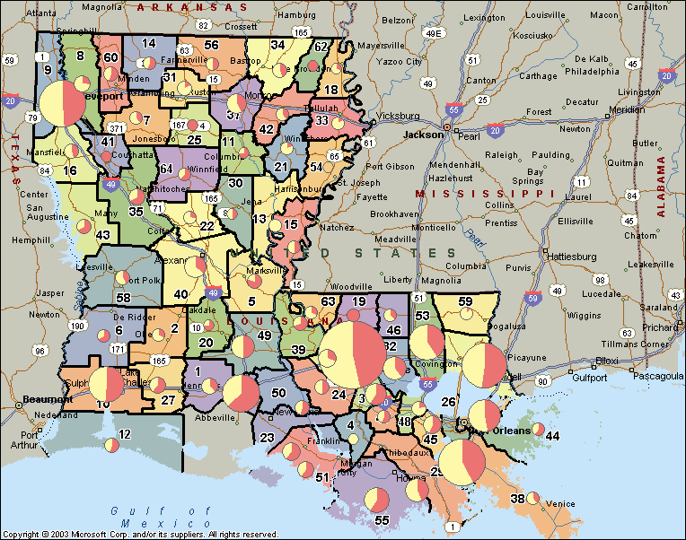
Arrests and
Alcohol-Related and
Non-Alcohol Related
Fatal Crashes 2007

Slide 35
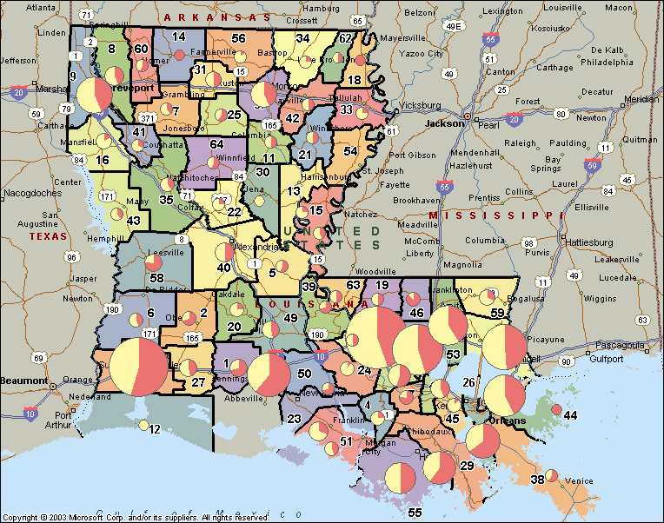
Arrests and
Alcohol-Related and
Non-Alcohol Related
Fatal Crashes 2008

Slide 36
2008 DWI Arrests
24,736 Arrests
11,047 Adult DWI
7,947 Refusals
1,637 Age 15-20 DWI
20,631 Total Refusals or over the limit

Slide 37
DWI Arrests by Troop
Troop | Arrests 2008 | Arrests 2007 | FTL CRSH 2008 | FTL CRSH 2007 | % Change DWI Arrests | % Change in DUI Fat.
A | 4539 | 4157 | 70 | 78 | 9% | -10%
B | 3102 | 3034 | 49 | 53 | 2% | -8%
C | 1405 | 1845 | 40 | 27 | -24% | 48%
D | 1676 | 1972 | 42 | 38 | -15% | 11%
E | 2048 | 3134 | 55 | 49 | -35% | 12%
F | 1854 | 2053 | 30 | 29 | -10% | 3%
G | 3463 | 3367 | 33 | 43 | 3% | -23%
I | 2693 | 3003 | 36 | 80 | -10% | -55%
L | 3956 | 2912 | 43 | 42 | 36% | 2%
Total | 24736 | 25477 | 398 | 439 | -3% | -9%

Slide 38
DWI Arrests versus DUI Fatal Crashes

Slide 39
Dustin T. (6 arrests)
Arrest Date | BAC | Age | OMV Date | Offense on OMV File as of 8/3/09 | Conviction date
16-Feb-06 | 0.156 | 22 |  | NOT IN FILE
25-Feb-06 | 0.145 | 22 | 2/25/2006 | submit to chemical test | 2/25/2006
31-Dec-06 | 0.069 | 23 | 12/31/2006 | careless driving | 2/8/2007
21-Jul-07 | 0.109 | 23 | 7/21/2007 | submit - 2nd | 7/21/2007
 |  |  | 7/21/2007 | DWI first offense | 10/3/2007
06-May-08 | 0.192 | 24 | 5/6/2008 | submit 3rd+ | 5/6/2008
29-Jul-08 | 0.223 | 24 | 7/29/2008 | submit 3rd+ | 7/29/2008

Slide 40
Joseph L. (5 arrests)
Arrest Date | BAC | Age | OMV Date | Offense on OMV File as of 8/3/09 | Conviction date
17-Jul-07 | 0.123 | 22 | 7/17/2007 | submit to chemical test | 7/17/2007
30-Aug-08 | 0.199 | 34 | 8/30/2008 | submit - 2nd | 8/30/2008
 |  |  | 8/4/2008 | careless driving | 10/24/2008
12-Nov-08 | 0.181 | 24 | 11/12/2008 | submit 3rd+ | 11/12/2008
 |  |  | 8/30/2008 | DWI first offense | 12/3/2008
 |  |  | 11/12/2008 | DWI second offense | 6/3/2009

Slide 41
Matthew G. (6 arrests)
Arrest Date | BAC | Age | OMV Date | Offense on OMV File as of 8/3/09 | Conviction date
30-Jul-05 | 0.127 | 17 |  | NOT IN FILE
28-Jan-06 | 0.023 | 18 |  | NOT IN FILE
11-Feb-06 | 0.062 | 19 | 2/11/2006 | submit underage | 2/11/2006
 |  |  | 2/11/2006 | underage driving under influence | 4/10/2006
05-Mar-06 | 0.091 | 18 | 3/5/2006 | DWI first offense | 8/22/2006
 |  |  | 11/5/2007 | refusal of chemical test | 11/5/2007
 |  |  | 10/28/2007 | speed excess of posted maximum | 1/7/2008
07-Dec-08 | 0.16 | 20 | 12/6/2008 | submit underage | 12/6/2008

Slide 42
John T. (5 Arrests with Refusals)
Arrest Date | Age | OMV Date | Offense on OMV File as of 8/3/09 | OMV Date
23-Oct-04 | 29 | N/A | Refusal no OMV record
23-Oct-05 | 30 | 10/23/2005 | Refusal of chemical test | 10/23/2005
25-Jan-06 | 30 | 1/25/2006 | Refusal of chemical test 2nd | 1/25/2006
04-May-06 | 31 | 5/4/2006 | Refusal of chemical test 3rd+ | 5/4/2006
21-May-06 | 31 | 5/21/2006 | Refusal of chemical test 3rd+ | 5/21/2006

Slide 43
Observations about DWIs
A spot check of 15 drivers with more than 5 arrests showed that six of the 15 drivers had 1st DWI, two had 2nd DWI, and two had 3rd DWI.
Are arrested drivers
  Prosecuted
  Convicted
  Reported to the OMV?
There is no way to know because of a lack of a tracking system.
Notes:
The arrest record also highlight a problem with the tracking, submitting and convictions reported to the OMV. A spot check of 15 drivers with more than 5 arrests showed that six of the 15 drivers had 1st DWI, two had 2ndDWI, and two had 3rd DWI.

Slide 44
Occupant Protection
Seat Belts
Motorcycle Helmets

Slide 45
Seat Belt Survey
6 out of the past 7 years the seat belt usage in the front seat was about 75%

Slide 46
Occupant protection
Seatbelt Use
Killed Occupants
75% of front-seat passengers were wearing a seat belt.
Thus the 25% of occupants who are not wearing a seat belt make up 65% of fatalities.
64% of drivers killed were reported not wearing a safety belt.
68% of passengers (5 years and older) killed were not wearing a safety belt.
Cost to Louisiana citizens $1.23 Billion in 2008
$432 for every licensed driver in 2008

Slide 47
While safety belt use has not changed much over the past six years…

Slide 48
…and the percent of occupants killed not wearing a safety belt is still over 60%...

Slide 49
Seat Belt Use and Driver Fatality
Troop | FATAL CRASH | DRIVER FATALITIES | SEAT BELT USED | SEATBELT NOT USED | %Total | % SEATBELT NOT USED
A (EBR) | 146 | 97 | 31 | 54 | 79.4% | 64%
B (NO) | 98 | 49 | 16 | 28 | 71.0% | 64%
C (Houma) | 72 | 32 | 11 | 17 | 90.4% | 61%
D (Lake Charles) | 81 | 45 | 16 | 23 | 72.5% | 59%
E (Alexandria) | 103 | 64 | 24 | 39 | 71.6% | 62%
F (Monroe) | 70 | 49 | 13 | 27 | 70.4% | 68%
G (Shreveport) | 79 | 51 | 14 | 29 | 72.6% | 67%
I (Lafayette) | 78 | 47 | 16 | 29 | 79.5% | 64%
L (Hammond) | 91 | 57 | 17 | 37 | 72.5% | 69%

Slide 50
% Fatalities w/o Seat Belt Use versus % Seat Belt Use Nationwide

Slide 51
Figure 6: Seat Belt Usage by Troop

Slide 52
Percent of Fatalities Not Wearing Seat Belt/Harness by Age

Slide 53
Seat Belt use in Back Seats
About 22 lives could have been saved in 2007 if the occupants would have worn seat belts
 | Back-Seat Safety Belt Usage Survey results
Region | %AUTO | %PKUP* | %SUV | %VAN | %Total
1 (NO) | 22.5% | 8.2% | 25.9% | 24.5% | 21.6%
2 (EBR) | 21.0% | 6.9% | 35.0% | 25.7% | 23.2%
3 (Houma) | 43.1% | 20.0% | 45.4% | 43.1% | 38.3%
4 (Lafayette) | 41.8% | 17.0% | 41.6% | 50.3% | 37.9%
5 ( Lake Charles) | 33.7% | 21.6% | 44.0% | 38.1% | 37.9%
6 ( Alexandria) | 30.1% | 8.8% | 25.3% | 9.2% | 29.9%
7 (Shreveport) | 21.9% | 10.2% | 14.2% | 25.7% | 20.4%
8 (Monroe) | 11.9% | 17.4% | 24.0% | 14.2% | 17.7%
Louisiana | 27.3% | 12.5% | 31.3% | 29.4% | 27.2%
* Extended multi-seat pickup trucks
Notes:
Continue tracking this

Slide 54
Multiple Vehicle Fatal Crashes
Alcohol & but Seat Belt Use
Notes:
Over 80% of fatalities occur in the vehicle of the drunk driver.

Slide 55
Motorcycle Fatalities
There were 80 motorcycle fatalities in 2008 which decreased by 9.1% from 2007.
There were 3.3 deaths of motorcycle drivers per 100 motorcycles in crashes for 2008 as compared to 3.6 in 2007.
Fatality percentage decreased from 4.4% before 2004 to 3.7% after 2004 which resulted in 17 fewer death in 2008.
Helmet use in motorcycle crashes was 88% in 2008 as compared to 83% in 2007.
Helmet use in fatal crashes was 76.3%.
Properly used helmets in fatal crashes was 62.5%.

Slide 56
Helmet Use
Helmet use in motorcycle crashes was 88% in 2008 as compared to 83% in 2007.
Helmet use in fatal crashes was 76.3%.
Properly used helmets in fatal crashes was only 62.5%.
Cost the Louisiana citizens $76 million

Slide 57
Number of Motorcycle Riders Killed in Crashes in Louisiana 1999-2008

Slide 58
Fatality by Alcohol and Helmet Use Average
Alcohol is a much larger contributing factor to the death rate than wearing a helmet (18.7% versus 3.2%).
4.5%

Slide 59
Single Vehicle Fatal Run-off-Road Crashes

Slide 60
Mandatory Helmet Law Benefits over past four years
Saved
  86 lives
  177 severe injuries
  129 moderate injuries
  $270 million

Slide 61
Aggressive Driving
Exceeding Stated Speed
Exceeding Save Speed
Failure to Yield
Following too closely
Driving left of center
Cutting in & Improper Passing
Disregard Traffic control
Careless Operation

Slide 62
Drivers in Fatal and Injury Crashes for Aggressive Driving
Type | Fatal | Injury | All | % Fatal | % Injury
Exceeding Stated Speed | 28 | 205 | 465 | 6.0% | 44%
Exceeding Safe Speed | 17 | 379 | 1008 | 1.7% | 38%
Failure to Yield | 68 | 9091 | 27641 | 0.2% | 33%
Following too closely | 3 | 5851 | 21373 | 0.0% | 27%
Driving left of center | 57 | 607 | 1745 | 3.3% | 35%
Cutting in/Improper Passing | 10 | 610 | 3209 | 0.3% | 19%
Disregard Traffic control | 30 | 2531 | 6117 | 0.5% | 41%
Careless Operation | 299 | 15843 | 46861 | 0.6% | 34%

Slide 63
Violation & Traffic Control Drivers in Fatal Crashes
(Note: Other violations are included in the margins.
 | Stop Sign | Yield Sign | Red Signal | yellow No Passing Lane | White Dashed Line | Yellow Dashed Line | No Control | Total
Exceeding Stated Speed | 1 |  |  | 9 | 4 | 8 | 6 | 28
Exceeding Save Speed | 1 |  |  | 5 | 3 | 2 | 4 | 17
Failure to Yield | 27 | 5 |  | 8 | 3 | 4 | 4 | 68
Following too closely |  |  |  |  | 1 | 1 |  | 3
Driving left of center |  |  |  | 25 | 2 | 27 | 3 | 57
Cutting in/Improper Passing |  |  |  | 2 | 3 | 3 |  | 10
Disregard Traffic control | 14 |  | 9 |  |  |  |  | 30
Careless Operation | 5 | 2 | 4 | 101 | 91 | 61 | 24 | 299
 | 56 | 9 | 19 | 352 | 331 | 234 | 97 | 1212

Slide 64
Violation/Traffic Control Drivers in Injury Crashes
 | Stop Sign | Yield Sign | Red Signal | yellow No Passing Lane | White Dashed Line | Yellow Dashed Line | No Control | Total
Exceeding Stated Speed | 13 | 1 | 4 | 44 | 53 | 21 |  | 145
Exceeding Save Speed | 15 | 3 | 11 | 97 | 101 | 38 |  | 279
Failure to Yield | 3203 | 424 | 375 | 829 | 883 | 317 |  | 7413
Following too closely | 122 | 290 | 853 | 807 | 2138 | 426 | 3 | 5174
Driving left of center | 6 |  |  | 287 | 58 | 165 |  | 526
Cutting in/Improper Passing | 6 | 2 | 11 | 92 | 287 | 97 |  | 525
Disregard Traffic control | 1022 | 13 | 1264 | 32 | 15 | 4 | 1 | 2475
Careless Operation | 606 | 318 | 1305 | 3719 | 4594 | 2133 | 4 | 13446
 | 4993 | 1051 | 3823 | 5907 | 8129 | 3201 | 8 | 35117

Slide 65
Changes in Intersection Crashes: 2007-2008
 | All |  |  | w/Side Impact
Parishes | Crashes | Fatalities | Injuries | Crashes | Fatalities | Injuries
EAST BATON ROUGE | 3% | -7% | 1% | -1% | -27% | -5%
ORLEANS | 8% | 6% | 6% | 8% | 18% | 6%
CADDO | -9% | -50% | -12% | -13% | -72% | -12%
JEFFERSON | -6% | -41% | -7% | -8% | -57% | -10%
LAFAYETTE | -1% | -7% | -6% | -3% | 0% | -6%
CALCASIEU | -9% | -18% | -2% | -5% | 0% | 0%
RAPIDES | -7% | 33% | 11% | -10% | 100% | 19%
ST. TAMMANY | -4% | -50% | 0% | 0% | -50% | 2%
OUACHITA | -4% | 50% | 7% | -2% | 150% | 9%
BOSSIER | -1% | -67% | 8% | 0% |  | 17%

Slide 66
Intersection Crashes
 | 2007 |  |  | 2008
Parishes | Crashes | Fatalities | Injuries | Crashes | Fatalities | Injuries
EAST BATON ROUGE | 11,264 | 15 | 5,203 | 11,573 | 14 | 5,277
ORLEANS | 6,826 | 17 | 3,924 | 7,339 | 18 | 4,178
CADDO | 5,873 | 22 | 2,942 | 5,353 | 11 | 2,597
JEFFERSON | 5,142 | 17 | 2,135 | 4,823 | 10 | 1,986
LAFAYETTE | 4,303 | 14 | 2,131 | 4,263 | 13 | 1,995
CALCASIEU | 2,753 | 11 | 1,763 | 2,498 | 9 | 1,731
RAPIDES | 2,301 | 3 | 1,146 | 2,131 | 4 | 1,272
ST. TAMMANY | 1,864 | 8 | 818 | 1,794 | 4 | 817
OUACHITA | 1,794 | 4 | 1,029 | 1,715 | 6 | 1,102
BOSSIER | 1,669 | 3 | 798 | 1,660 | 1 | 859

Slide 67
Average Age of Violator
Violation | Average Age
Exceeding Stated Speed | 29
Exceeding Save Speed | 31
Failure to Yield | 39
Following too closely | 34
Driving left of center | 38
Cutting in/Improper Passing | 38
Disregard Traffic control | 38
Careless Operation | 34
Average | 37

Slide 68
Cell Phone use and Texting and Driving

Slide 69
Business Intelligence
(BI)
Objective
  Provide simple measures
  Provide measures that relate to specific efforts that are taken or can be taken
  Provide timely information

Slide 70
Fatalities-$1.3 Billion

Slide 71
Injury Crashes $4 Billion
Injuries per 1,000 Crashes
Injuries per 100 Million Miles Traveled

Slide 72
Occupant Protection –
1.3 Billion

Slide 73
Alcohol - $1.3 Billion

Slide 74
Aggressive Driving
$4.2 Billion

Slide 75
Cost $112 Million

Slide 76
Type | Total Cost | Cost per Licensed Driver
Fatalities | $1.3 Billion | $445
Injuries | $4.3 Billion | $1,521
Motorcycles | $282 Million | $99
Pedestrian | 317 Million | $112
Lack of Seat Belt | $1.2 Billion | $432
Alcohol | $1.3 Billion | $454
Aggressive Driving | $4.2 Billion | $1,479
Total | $6.43 Billion | $2,264

Slide 77
Crash Clock
Fatalities Occur Every
Hours | Minutes | Seconds
9.0 | 37 | 11
Injuries Occur Every
Hours | Minutes | Seconds
0 | 6.0 | 56
Property Damage Only Crashes Occur Every
Hours | Minutes | Seconds
0 | 4.0 | 45
Crashes Occur Every
Hours | Minutes | Seconds
0 | 3.0 | 20

Slide 78
In the 2 hours of my presentation
hopefully nobody died in a car crash, but
40 crashes occurred with
17 injuries.
In these two hours we had a costs of $1.5 million occur for the citizens of Louisiana, on the average.

