Slide 1

Louisiana Traffic Records Data Report 2011
hsrg.lsu.edu
Lacrashdata.lsu.edu
Presented by Dr. Helmut Schneider

Slide 2
Fatalities and Fatal Crashes have declined in 2011 for the Fourth year in a row

Slide 3
Fatality Rate
Fatalities per 100 Million Miles

Slide 4
Fatal Crashes by Quarter

Slide 5
Fatal Crashes per 1000 Crashes

Slide 6
Fatal Crash Rate of Youth Drivers Declined

Slide 7
Fatal Interstates Crashes

Slide 8
Fatal Train Crashes

Slide 9
Pedestrian Fatalities

Slide 10
Bicycle Fatalities

Slide 11
Motorcycle Fatalities

Slide 12
Driver Fatalities per 100 Drivers in Crashes

Slide 13
Number of Motorcycles in Crashes

Slide 14
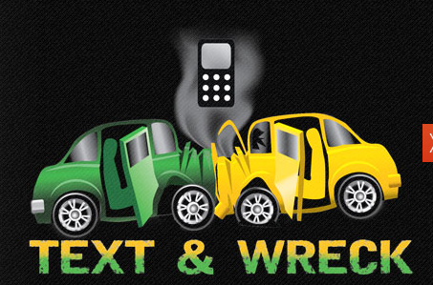
Distractions

Slide 15
Distractions

Slide 16
Cell Phone in Crashes

Slide 17
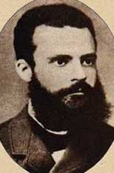
Pareto: The 20-80 Rule
Over 85% of driver fatalities involved one of these three factors of the driver killed.
Lack of Seatbelt Use
Aggressive
Driving
Alcohol
61%
78%
73%
23%
55%
43%
71%
Notes:
2011
driver 359
alcohol 158 44%
no seatbelt 218 61%
Aggress dr 196 55%
alc_or_No_sb 260 73%
al_aggress 253 71%
sb_aggressive 278 78%
all three 84 23%
any of three 303 85%

Slide 18

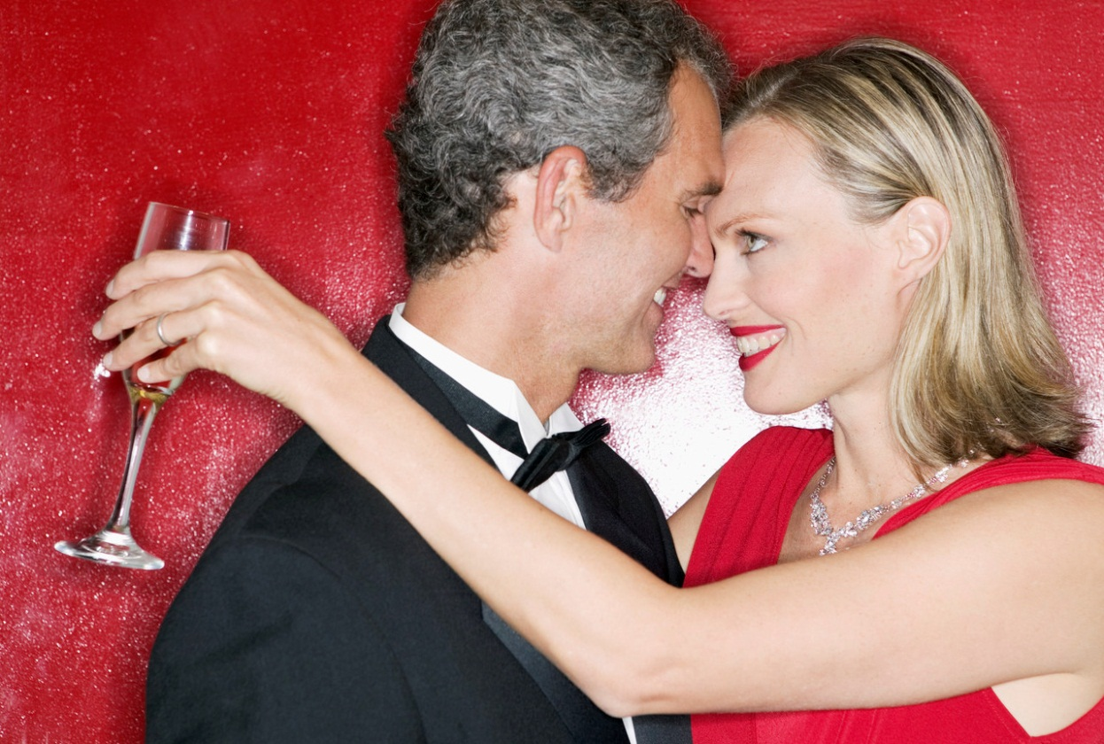
Alcohol

Slide 19
Percent Alcohol Related Fatalities

Slide 20
Pending and Unknown BAC

Slide 21
Fatal Crash Rate of Youths Drivers In Alcohol Crashes Declined

Slide 22
DWI Arrests
2004-2011

Slide 23
DWI Arrest by Troop
2006-2011
Bubble Size is Number of Licensed Drivers

Slide 24
Alcohol-Related Fatalities by Troop Area
2006-2011
Alcohol by troop.htm
Bubble Size is Number of Fatal Crashes

Slide 25
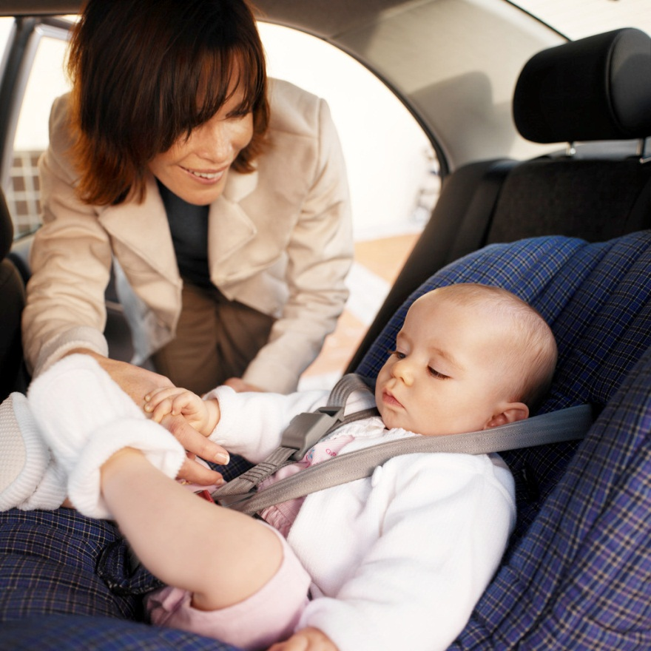
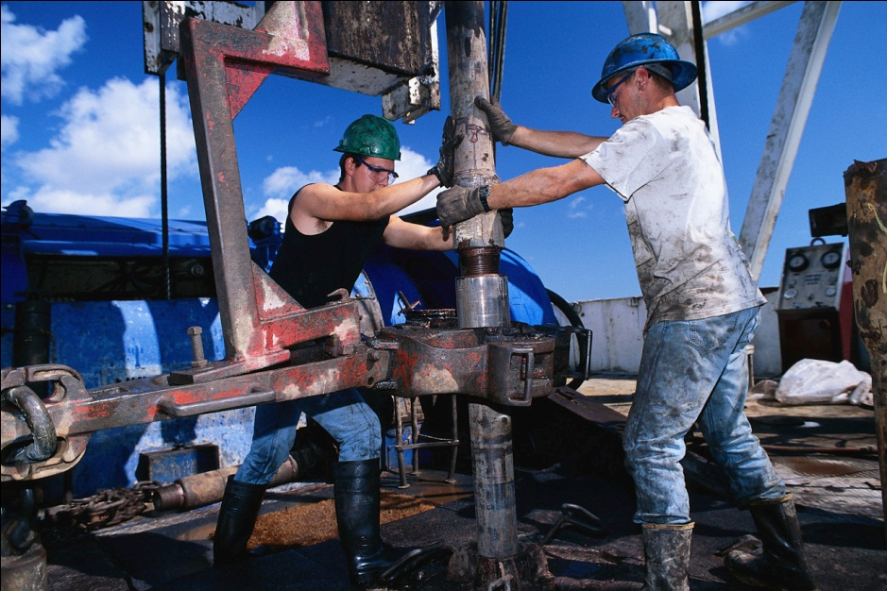
Safety

Slide 26
Front Seat-Belt Use in Surveys and Fatal Crashes

Slide 27
Vehicle Type
Vehicles on Roads
Driver Fatalities No Seat Belt

Slide 28
Seat Belt Use of the
Population of Licensed Drivers versus Drivers on Roads
Licensed Drivers (80.3%)
Drivers on Road (79.3%)

Slide 29
Seat-Belt Survey Results by Region

Slide 30
Seat Belt Use by Troop

Slide 31
Seat-Belt Use by Highway Type

Slide 32
Seat-Belt use of Fatal Drivers

Slide 33
Seat-Belt Use by Vehicle Type

Slide 34
Seat-Belt Use of driver Fatalities

Slide 35
Seat-Belt Use by Sex

Slide 36
Seat-belt Use by Race

Slide 37
Seat-Belt Use for Fatalities

Slide 38
Belt Use for Fatal Occupants in Back Seats

Slide 39
Alcohol and Seat-Belt Use
Bubble Size Number of Fatal Crashes

Slide 40
Data Access
http://hsrg.lsu.edu

