Slide 1
Statistical Thinking in
Highway Safety
Helmut Schneider

Slide 2
Overview
The need for statistical thinking
Design of Experiments
Modeling Crashes
  The Poisson Distribution
  The Negative Binomial Distribution
  Covariates
  AADT
  Length of road segment
Regression to the Mean & Empirical Bayes
Black Spots & Ranking

Slide 3

Thinking Fast and Slow
Do we possess intuitive judgments involving decisions involving statistics?
A bat and ball costs $1.10
The bat costs one dollar more than the ball.
How much does the ball cost?
(a) 10 cents?
(b) 5 cents?

Slide 4
Judging Probabilities
A driver was involved in a single vehicle fatal crash at night.
Here is what we know about the driver:
  had a history of drug use
  has been arrested for 3 DWI’s before this crash
  the crash occurred after midnight
Rank the following according to their probabilities:
  Driver is a male and had been drinking before the crash
  Driver is a male
  Driver was male and used alcohol and drugs
  Driver used alcohol and drugs
Notes:
B,(a,d),c

Slide 5
Learning Objectives
To understand the following design issues:
    Randomized
    Controlled
    Confounding
    Bias
    Significance
Notes:
The learning objectives of this lesson are to understand the difference between Exploratory Data Analysis and Confirmatory Data Analysis
AND
To understand the important issues in experimental design and how to address them.
The following design issues will be covered: Confounding, Bias, and Significance

Slide 6
Data Analysis Comparison
 |  | Data Analysis Type
 |  | Confirmatory Data Analysis (CDA) | Exploratory Data Analysis(EDA)
Study Characteristic | Approach | Deductive | Inductive
 | Assumptions | Accepted | Questioned
 | View | Narrow | Broad
 | Purpose | Look for definite answers to specific questions | Let data suggest questions that should be asked
 | Statistics | Inferential | Descriptive
 | Emphasis | Numerical Calculations | Graphical Displays
Notes:
Before we get started, let’s review two data analysis methods by looking at a side by side comparison.
Confirmatory data analysis uses a deductive approach based on accepted assumptions and only looks at a narrow piece of the whole picture. On the other hand, exploratory data analysis is an inductive approach that questions assumptions and looks at what the whole picture has to say.
Confirmatory data analysis is a search for definitive answers to specific, pre-determined questions, using inferential statistics and numerical calculations to evaluate data.
Exploratory data analysis is a search for the questions that the researcher should be asking using descriptive statistics and graphical displays to show what the data is saying.
Now let’s continue to explore the Confirmatory Data Analysis approach through a series of real world examples from Freedman, Pisani and Purves Statistics . Although these examples are not from the transportation field they demonstrate the issues associated with experimental designs and data analysis.

Slide 7

Polio Epidemic Timeline
1916 Polio epidemic hits the US
1950s Several promising vaccines developed
1954 Salk vaccine sees success in laboratory trials and is deemed ready for real world trials
Notes:
The first polio epidemic hit the United States in 1916, and during the next forty years polio claimed many hundreds of thousands of victims, especially children. By the 1950s, several vaccines against this disease had been discovered. The one developed by Jonas Salk seemed the most promising. In laboratory trials, it had proved safe and had caused the production of antibodies against polio. By 1954, the Public Health Service and the National Foundation for Infantile Paralysis (NFIP) were ready to try the vaccine in the real world—outside the laboratory.
Let’s take a look at a few potential experimental designs.
Source: Statistics, Freedman et al.

Slide 8

Design Issues
Vaccine distributed to all children in 1953
Parental consent:
  Treatment: Children with parental consent
  Control Children without consent
Choosing Groups:
  Treatment Group: Grade 2 children with consent
  Control Group: Grades 1 and 3 children
No Control Group: epidemic disease - incidence varied from year to year
How does that apply to roads?
Selection Bias – Confounding:
Rich versus Poor
Selection Bias: Polio is a contagious disease, spreading through contact.
How does selection bias that apply to roads?

Slide 9
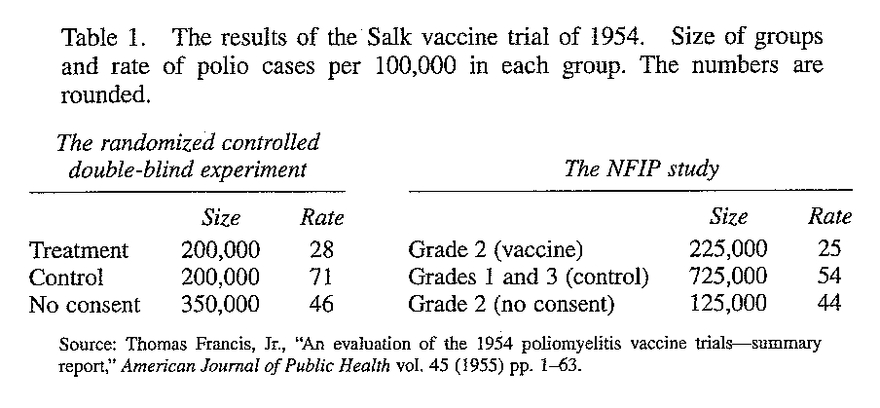
THE SALK VACCINE FIELD TRIAL
Notes:
Table 1 shows the rate of polio cases (per hundred thousand subjects) in the randomized controlled experiment, for the treatment group and the control group. The rate is much lower for the treatment group, decisive proof of the effectiveness of the Salk vaccine.
The table also shows how the NFIP study was biased against the vaccine. In the randomized controlled experiment, the vaccine cut the polio rate from 71 to 28 per hundred thousand; the reduction in the NFIP study, from 54 to 25 per hundred thousand, is quite a bit less.
The main source of the bias was confounding. The NFIP treatment group included only children whose parents consented to vaccination. However, the control group also included children whose parents would not have consented. The control group was not comparable to the treatment group.
With the NFIP design, the results are affected by many factors that seem random: which families volunteer, which children are in grade 2, and so on. However, the investigators do not have enough information to figure out the odds against a big difference in polio rates being due to accidental factors. With a randomized controlled experiment, on the other hand, chance enters in a planned and simple way—when the assignment is made to the treatment or control.
The randomized controlled double-blind design reduces bias to a minimum—the main reason for using it whenever possible. But this design also has an important technical advantage. To see why, let’s play devil's advocate and assume that the Salk vaccine had no effect. Then the difference between the polio rates for the treatment and control groups is just due to chance. How likely is that?
Source: Statistics, Freedman et al.

Slide 10
Quasi-Experimental Design
Before-and-After Studies
A quasi-experimental design: experimental design that surveys exposures and disease status before and after an intervention to determine treatment effect
Advantage: Low cost, convenience, simplicity
Disadvantage: Potential confounding factors
Time
Period
Before
Time
Period
After
time
Intervention
Starts Here
Notes:
Before and after studies are a type of observational study. They measure exposures at two time points. The first time point is before the initiation of an intervention or treatment. An intervention is introduced, and the second time point is after the intervention has begun. The goal of the design is to examine if the exposure/injury link has changed over time. In theory, any change would be due to the intervention.
Before and after studies use the before period as “control”. This eliminates some possible confounding factors associated with comparing two groups. However, any changes that occur over time are possibly confounding the experiment. The main disadvantage of before and after designs is the lack of a comparison or control group. This limits the value of information obtained on the exposure-injury link. Without a control group, it is difficult to establish the cause and effect relationship between the exposure and an injury.
The major reason for the popularity of the before and after study design is the low cost, convenience and simplicity in conducting the studies. In the injury area, another advantage of this design is its usefulness in addressing the ethical issues that may come up with randomized studies or prospective cohort designs. Consider the ethics of exposure to alcohol. Several studies in this area are not possible because the risk-benefit ratio in the studies are not acceptable.
Before looking at an example of a before and after study, let’s take a few minutes to explore the regression to the mean phenomenon.

Slide 11
Best Practice
In Design of Experiments
Randomized
Controlled
  Placebo: Giving a harmless treatment to those in the control group so they are not aware they are getting the actual treatment.
Double Blind
  Experimental design where neither the subject nor the observer are aware of whether the subject received the treatment.
  Does this apply to highway safety?
Notes:
Another basic precaution was the use of a placebo: children in the control group were given an injection of salt dissolved in water. During the experiment the subjects did not know whether they were in treatment group or in control group, so their response was to the vaccine, not the idea of treatment. It may seem unlikely that subjects could be protected from polio just by the strength of an idea. However, hospital patients suffering from severe post-operative pain have been given a "pain killer" which was made of a completely neutral substance: about one-third of the patients experienced prompt relief.
Yet another precaution is to make sure the doctors don’t know who is receiving the actual treatment. Diagnosticians had to decide whether the children contracted polio during the experiment. Many forms of polio are hard to diagnose, and in borderline cases the diagnosticians could have been affected by knowing whether the child was vaccinated. So the doctors were not told which group the child belonged to. This is called double blinding: the subjects did not know whether they got the treatment or the placebo, and neither did those who evaluated the responses.
The combination of these different design elements results in a randomized controlled double-blind experiment. This is about the best design there is and it was used in many school districts.
Source: Statistics, Freedman et al.

Slide 12
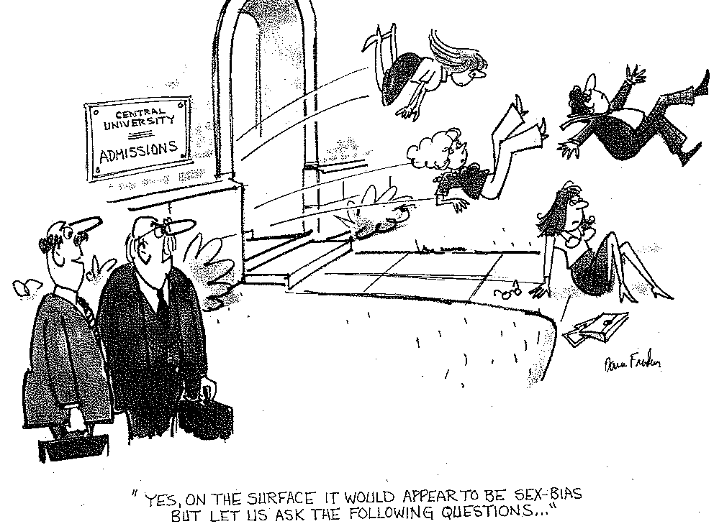
Confounding
Admission Rates at Berkeley
  44% of males
  35% of females
Source: Statistics, Freedman et al.
Notes:
To review briefly, a confounding variable is an extraneous variable in a statistical model that correlates (positively or negatively) with both the dependent variable and the independent variable. One source of trouble in observational studies is that subjects differ among themselves in crucial ways besides the treatment. So we try to adjust for these differences, by comparing smaller and more homogeneous subgroups, as discussed in the smoking experiment. Let’s look at an example of a confounded observational study.
This observational study on sex bias in admissions was done by the Graduate Division at the University of California, Berkeley. During the study period, there were 8,442 men who applied for admission to graduate school and 4,321 women. About 44% of the men and 35% of the women were admitted. Taking percents adjusts for the difference in numbers of male and female applicants: 44 out of every 100 men were admitted, and 35 out of every 100 women were admitted. Assuming that the men and women were on the whole equally well qualified, the difference in admission rates looks like a strong piece of evidence to show that men and women are treated differently in the admissions procedure.
Each major was responsible for their own graduate admissions. By looking at them separately, the university should have been able to identify the ones which discriminated against women. At that point, a puzzle appeared. Major by major, there did not seem to be any bias against women: Some majors favored men, but others favored women. On the whole, if there was any bias, it ran against the men. What was going on?
Over a hundred majors were involved. However, the six largest majors together accounted for over one-third of the total number of applicants to the campus. And the pattern for these majors was typical of the whole campus.
Source: Statistics, Freedman et al.

Slide 13
Results
Admission Rates at Berkley
Confounding!
 |  | Male |  |  | Female
Major |  | Number of Applicants | Percent Admitted |  | Number of Applicants | Percent Admitted
A |  | 825 | 62% |  | 108 | 82%
B |  | 560 | 63% |  | 25 | 68%
C |  | 325 | 37% |  | 593 | 34%
D |  | 417 | 33% |  | 375 | 35%
E |  | 191 | 28% |  | 393 | 24%
F |  | 373 | 6% |  | 341 | 7%
Total |  | 2691 | 45% |  | 1835 | 30%
Source: Statistics, Freedman et al.
Notes:
The Table shows the number of male and female applicants, and the percentage admitted, for each of these majors.
Source: The Graduate Division, University of California, Berkeley.
In each major, the percentage of female applicants who were admitted is roughly equal to the percentage for male applicants. The only exception is major A, which appears to discriminate against men; it admitted 82% of the women but only 62% of the men. The department that looks most biased against women is department E. It admitted 28% of the men and 24% of the women. This difference only amounts to 4 percentage points. However, when all six majors are taken together, they admitted 45% of the male applicants, and only 30% of the females—the difference is 14 percentage points. This seems paradoxical, but here is the explanation: The first two majors were easy to get into. Over 50% of the men applied to these two majors. The other four majors were much harder to get into. Over 90% of the women applied to these four majors.
The men were applying to the easy majors, the women to the harder ones. There was an effect due to the choice of major; confounded with the effect due to sex. When the choice of major is controlled for, as in table 2, there is little difference in the admissions rates for men or women. The statistical lesson: relationships between percentages in subgroups (for instance, admissions rates for men and women in each department separately) can be reversed when the subgroups are combined. This is called Simpson's paradox.
The calculations for the weighted average for admission rates of men and women are displayed on screen.
MEN: (.62X933 +.63X585 + .37X918 + .33 X792 + .28X584 + .06X714)/4,526 = 39%
WOMEN: (.82x933 + .68x585 + .34x918 + .35x792 + .24x584 + .07x714 )/4,526 = 43%
For men, the weighted average works out to 39%. The weighted average for the women works out to 43%. These weighted averages control for the confounding factor – the choice of major. These averages suggest that if anything, the admissions process is biased against the men.

Slide 14
Completely Randomized Design
Treatment | Observations
1 | y₁₁, y₁₂, …y_{1n}
2 | y₂₁, y₂₂, …y_{2n}
3 | y₃₁, y₃₂, …y_{3n}
4 | y₄₁, y₄₂, …y_{4n}
Notes:
A completely randomized design has the form shown in the table of this slide. Each row represents a treatment and the columns represent the observations. In this case there are 4 treatments and n observations for each treatment.

Slide 15

Estimating the Effect of a Treatment
Example Research Question:
  Do different tire types have different wear after being driven 20,000 miles?
How can we answer the question?
  Random sample of tires on 4 similar cars
  Measure the wear after 20,000 miles
  Use a designed experiment to evaluate differences
Notes:
We will consider a simple designed experiment of analyzing the effect of a treatment on a response.
We want to know if four different tire types have different wear when driven for 20,000 miles.
How can we best answer this question? We could select a random sample of tires on cars and measure the wear on the tires after 20,000 miles. Regression could then be used to estimate if there is a difference between the tire types. However, using such a random sample without a design and linear regression to estimate differences is an observational study. It has the advantage of using available data, but lacks all the advantages of designed experimentation as discussed in lecture 1. Performing a regression to obtain treatment effects, in this case, has many drawbacks and may lead to questionable conclusions because of the many confounding factors.
To best answer the question, we will discuss the use of a designed experiment to evaluate the differences. This will show its advantages over regression type analysis using the existing data.

Slide 16
Example
Symbol | Description | Sample Size
k = 1,…,p | Number of tire types (TREATMENT) | p = 4 tire types
i = 1,….,n | Number of tires in each treatment | n = 4 tires
Y_{ki} | Wear on the tread in 1/10 of an inch of the tire type k in sample i after 20,000 miles
 | Average difference of the k^{th} treatment to the overall mean
τ_{k}
Notes:
In our example, the treatment is the tire type. There will be four tire types and four tires in each treatment. The sample could be larger or smaller, but for practical reasons four tires allow a nice design. The 16 tires will be put on 4 cars randomly and the response will be the wear on the tires after 20,000 miles are driven.
At this stage of the design we should consider possible confounding factors such as tire position, driver, tire pressure, road condition, urban-rural driving, breaking, and the like. In this design all these factors will show up in the error, and provided the design is randomized, we assume that on the average the error is zero.

Slide 17
The Data
 |  | Tire Number (i)
 |  | 1 | 2 | 3 | 4
Tire Type (k) | 1 Michelin | 13 | 17 | 14 | 13
 | 2 Firestone | 14 | 14 | 8 | 13
 | 3 Goodyear | 12 | 10 | 12 | 9
 | 4 Continental | 13 | 11 | 11 | 9
Notes:
This slide shows the results of the experiments. The numbers represent the wear on each tire. For instance, the sample of four tires of tire type 1 had the following wear measured in millimeters: 13, 17, 14 and 13. In the next slides we will compute the individual means for each tire type and the overall mean. After that we will ask the question if the tire type had an effect on the wear. This question will be answered using the Analysis of Variance table and the Fisher F test.

Slide 18
Calculate Sample Means
 |  | Sample Number (i)
 |  | 1 | 2 | 3 | 4 | Average
Tire Type (k) | 1 Michelin | 13 | 17 | 14 | 13
 | 2 Firestone | 14 | 14 | 8 | 13
 | 3 Goodyear | 12 | 10 | 12 | 9
 | 4 Continental | 13 | 11 | 11 | 9
Notes:
After the data are collected, the first step is to calculate the sample means for each observation group. The sample means are denoted by y bar and are calculated using a simple average formula. The calculation for Tire Type 1 is shown on screen. This process is repeated for all four of the tire types.

Slide 19
Calculate Overall Mean
Overall mean denoted by:
or
 |  | Sample Means
Tire Type (k) | 1
 | 2
 | 3
 | 4
Notes:
Since we are attempting to determine if these observations have a common mean, we need to form an estimate of this common mean so we can test if they are statistically equivalent. We will need the overall mean to do this. The overall mean is denoted here by y double bar, but is also denoted by mu.
The overall mean is simply the sum of the sample values divided by the total number of sample observations. The formula and calculations are shown on the slide.

Slide 20
Mathematical Model
We want to know if the effect is significant!
Notes:
To better understand the relationship between the response and the treatment, one expresses the relationship in mathematical terms. The tau representing the change from the overall mean the treatment has on the wear of the tires. There are p different treatments thus p different taus, which is the difference between the individual means and the overall mean (blue lines versus yellow line). There is also an error term which accounts for all unexplained variation which is the difference between the individual values in the graph and the tire type means (blue lines). This error is assumed to be normally distributed with mean zero and standard deviation sigma. The sample size is denoted as “n”.

Slide 21
Lily Pads
In a lake , there is a patch of lily pads. Every day, the patch doubles in size.
If it takes 48 days for the patch to cover the entire lake, how long would it take for the patch to cover half the lake?
(a) 24 days
(b) 47 days
(c) 36 days

Slide 22
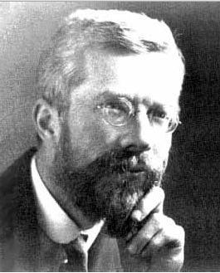
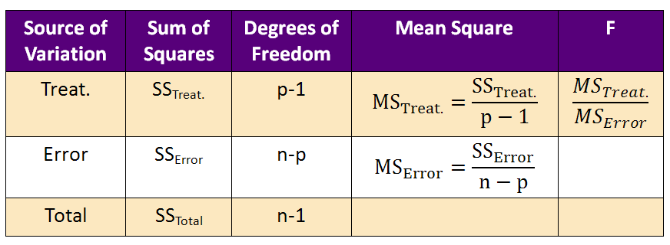
ANOVA Table
English statistician, evolutionary biologist, eugenicist, and geneticist.
(February 17, 1890 – July 29, 1962)
If F > F_{(p-1),(n-p);0.95}, there is an effect
Notes:
The Analysis of Variance table, abbreviated as ANOVA table, is a tool that partitions the variation into two parts: the variation due to treatment and the variation due to error. An ANOVA table for randomized designs always has the same columns and each row provides the source of the contribution to the overall variance. We will see that we can add additional rows to this ANOVA table if we find additional soruces of variation and include them into the design. Also, note that the sum of squares Total (called SSTotal) measures the total variation in the data regardless of any effects. The objective of an ANOVA table is to partition the total variation into parts so that they can be clearly identified and their statistical significance evaluated. In the next few slides, we will explore each of these values and calculate them for our example.

Slide 23
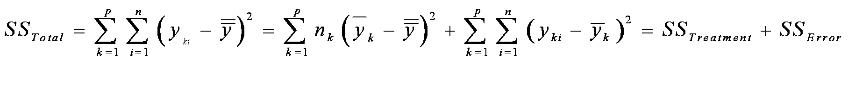
Partition of Variation
Within versus Between
Test the equality of the population means by comparing the two variability components:
    Within Groups Variability (SS_{Error}):
      variability about the individual sample means within the k groups of observations
    Between Groups Variability (SS_{Treat}):
      variability among the k group means.
Notes:
Now we want to test the equality of the population means. We do this by comparing two types of variability. The within groups variability called sum of square error (in short SS Error from the ANOVA table) and the between groups variability called sum of square treatment (or SS Treatment from the ANOVA table). In the following we will use the short form SS for sum of square.
Within groups variability is the variability about the individual sample means within the k groups of observations. We denote this value as SS_Error.
Between groups variability is the variability among the k group means. We denote this as SS_Treatment.
The SS total is simply equal to SS_Error plus SS_Treatment
The next step is to calculate the between groups variability, SS_Treatment.

Slide 24
ANOVA Table
Source of Variation | SUM of Squares | Degrees of Freedom | Mean Square | F
Treatment | 30.6 | 3 | 10.2 | 2.43
Error | 50.3 | 12 | 4.2
Total | 80.9 | 15
Test for Treatment Effect 2.43 < F_{3,12,0.95}=3.49
Thus no evidence for a difference between the tire types.
Notes:
The ANOVA table is now filled in with the relevant data calculated in the previous slides. Note that the values have been rounded for convenience.
The computed F value is 2.43, which is smaller than the respective F value from the F distribution with 3 and 12 degrees of freedom at a 95% confidence level. Because the computed F statistic is smaller than the critical F value we say that at a 95% confidence level, the treatment is not statistically significant. There is less than 95% certainty that there is a treatment effect and therefore we are not confident enough to say that the difference did not occur just by chance. Therefore there is not enough evidence to support that there was a treatment effect of tire type on wear.

Slide 25
Block Design
The number of units (tires) in each block is the same
Each block contains each treatment at least once
Treatments are randomized within each block
 |  | BlocksB
 |  | Car 1 | Car 2 | Car 3 | Car 4
Treatment | 1 Michelin | Y₁₁ | y₂₁ | y₃₁ | y₄₁
 | 2 Firestone | y₁₂ | y₂₂ | y₃₂ | y₄₂
 | 3 Goodyear | y₁₃ | y₂₃ | y₃₃ | y₄₃
 | 4 Continental | y₁₄ | y₂₄ | y₃₄ | y₄₄
Notes:
The restrictions for this design are:
the number of units, in this case tires, in each block must be the same,
each block must contain each treatment at least once
within each block the treatments must be randomized.

Slide 26
Mathematical Model
Notes:
The mathematical model now includes a second parameter accounting for the block effect of the car. Again on average the block effect cancels out, because some cars will have an above average effect on the wear while others have a below average effect on the wear.

Slide 27
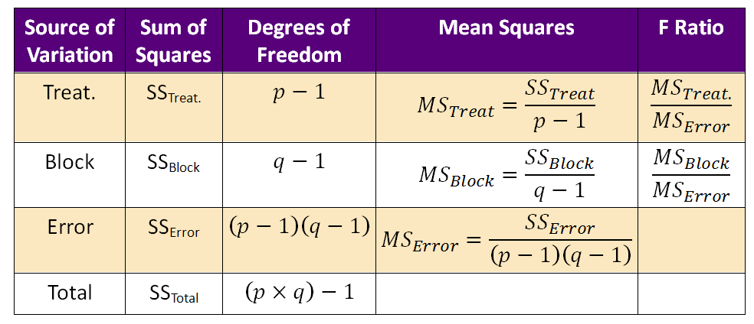
ANOVA Table with Blocking
Partition of Variation
Treatment Effect | If F > F_{p-1, (p-1)(q-1)}; 0.95
Block Effect | If F > F_{q-1,(p-1)(q-1)}; 0.95
Notes:
This is the ANOVA table which now has an additional row. The block effect and the sum of square block is computed the same way as the treatment effect and SS Treatment was computed. The treatment effect is still computed as the ratio of MS_Treat and MS_Error. You will notice a new variable, q. This is simply the number of blocks in the experiment. The F Ratio for the Block is MS_Block divided by MS_Error.
The SS treatment is unchanged by the addition of the block. Similar to the previous example, we begin by calculating the sample means for each group.

Slide 28
Calculate Sample Means for Each Group
 |  | Car (Block)
 |  | 1 | 2 | 3 | 4 | SUM | AVG
Tire Type (k) | 1 | 17 | 14 | 13 | 13 | 57 | 14.25
 | 2 | 14 | 14 | 13 | 8 | 49 | 12.25
 | 3 | 12 | 12 | 10 | 9 | 43 | 10.75
 | 4 | 13 | 11 | 11 | 9 | 44 | 11
Treatment | Tire Type (p) = 4
Blocks | Sample (q) = 4
Notes:
The first step is to calculate the sample means for each tire type, but of course the responses are exactly the same as in the randomized design.

Slide 29
Calculate Sample Means for Each Block
 |  | Block – by Car (j)
 |  | 1 | 2 | 3 | 4
Tire Type (k) | 1 | 17 | 14 | 13 | 13
 | 2 | 14 | 14 | 13 | 8
 | 3 | 12 | 12 | 10 | 9
 | 4 | 13 | 11 | 11 | 9
 | SUM | 56 | 51 | 47 | 39
 | AVG | 14.00 | 12.75 | 11.75 | 9.75
Notes:
The next step is to calculate the sample means for each block using a simple average formula. The formula and calculation for the first block are shown on screen. The same process applies to blocks 2-4.

Slide 30
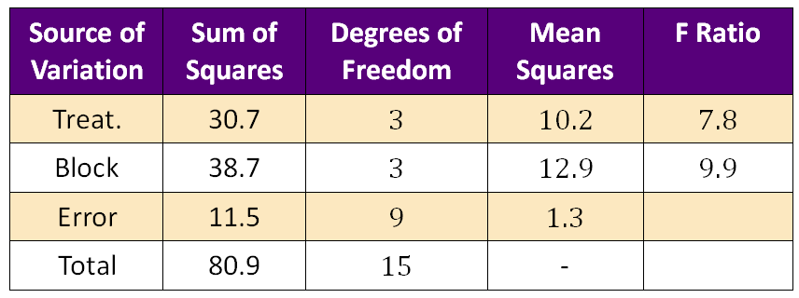
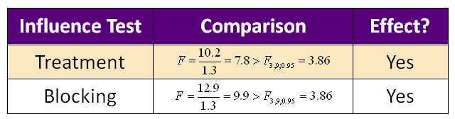
ANOVA Table
Notes:
In comparison with the first evaluation, the F distribution now shows that the tire type has a significant effect on wear. This example clearly demonstrates how the reduction of the error leads to a test with more power to distinguish between the null and alternative hypothesis and thus enables us to see that there was a treatment effect. The SS error was reduced from 50.3 to 11.5, where 38.7 was accounted for by the variation created by the cars used. Please note that the values in the ANOVA table have been rounded for convenience.

Slide 31


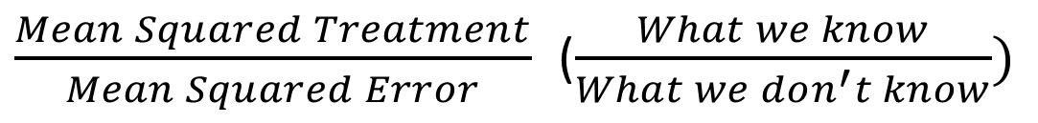
Things to Remember
Confounding
  lead to bias,
  affect the error.
Confounding affects significance testing.
The significance test is a ratio of
People
$\frac{Mean Squared Treatment}{Mean Squared Error}$ ($\frac{What we know}{What we don^{′}t know})$
Notes:
Confounding factors not only create bias, but also affect the error.
Confounding factors affect significance testing because the variation caused by the confounding factors reduces our ability to determine if the effect is real.
The significance test is a ratio of the measure of the variation due to treatment and a measure of variation due to error. One should always minimize the effect of extraneous factors on the results of the experiment.

Slide 32
Things to Consider
Think about the following issues in relation to highway safety studies: Control, Randomization, Confounding and Significance.
How can these issues be addressed in practical situations?
What is a good study design to evaluate:
  The effect of red right cameras on crash reduction
  The effect of rumble strips on run-off road crashes
  Other countermeasures - CMF
Notes:
Now take a few moments to put these concepts to use.
Consider control, randomization, confounding and significance in relation to highway safety studies.
How can these issues be addressed in practical situations?
What are the practical issues that affect the outcome of the experiment?
What is a good study design to evaluate:
The effect of red right cameras on crash reduction
The effect of rumble trips on run-off road crashes

Slide 33
Single versus Multiple Regression
$$Y=2×X1+2×X2+2×X3+Error$$
ANOVA for Multiple Regression
 | df | SS | MS | F | Significance F
Regression | 3 | 1631 | 543 | 200 | 10E-12
Residual | 14 | 38 | 2.7
Total | 17 | 1669
 | Coeff | Standard Error | t Stat | P-value
Intercept | 3.6 | 1.8 | 1.99 | 0.06
X1 | 2.03 | 0.23 | 8.6 | 5E-07
X2 | 1.95 | 0.17 | 11.2 | 2E-08
X3 | 1.95 | 0.15 | 12.8 | 3E-09

Slide 34
Hit-and-Run Taxi Cab
A taxi cap was involved in a hit-and-run crash at night.
Two cap companies, the red and the blue, operate in the city. Here are the data:
85% if the caps in the city are red and 15% are blue.
A witness identifies the cap as blue.
The court conducts an experiment with the witness of identifying colors at night correctly. The experiment reveals that the witness identifies the correct color 80% of the time.
What is the approximate probability that the taxi cap is blue?
(a) 90%, (b) 80%, (c) 70%, (d) 60%, (d) 40%

Slide 35
Decision Accuracy in Judging Injury Severity
 |  | TRUE
 |  | No Injury | Injury (B,C) | Marginal | Conditional
Decision | No Injury
 | Injury (B,C)
 |  | 99.0% | 1.0%

Slide 36
Decision Accuracy in Judging Injury Severity
 |  | TRUE
 |  | No Injury | Injury (B,C) | Marginal | Conditional
Decision | No Injury | 95.0% | 5%
 | Injury (B,C) | 5% | 95%
 |  | 99.0% | 1.0%

Slide 37
Decision Accuracy in Judging Injury Severity
 |  | TRUE
 |  | No Injury | Injury (B,C) | Marginal | Conditional
Decision | No Injury | 95.0% | 5% |  | 99.9%
 | Injury (B,C) | 5% | 95% |  | 16.1%
 |  | 99.0% | 1.0%

Slide 38
Decision Accuracy in Judging Injury Severity
 |  | TRUE
 |  | No Injury | Injury (B,C) | Marginal | Conditional
Decision | No Injury | 95.0% | 5% | 94% | 99.9%
 | Injury (B,C) | 5% | 95% | 6% | 16.1%
 |  | 99.0% | 1.0%

Slide 39
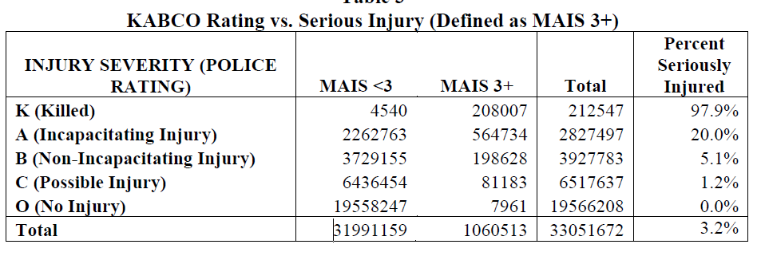
Application to Injury Severity
Maximum AIS (MAIS)
  across all coded injuries is often used as a measure of overall injury level for an occupant.
  MAIS of 3 or greater (MAIS 3+) is commonly used as the cutoff for defining serious injury.
ICD-9

Slide 40
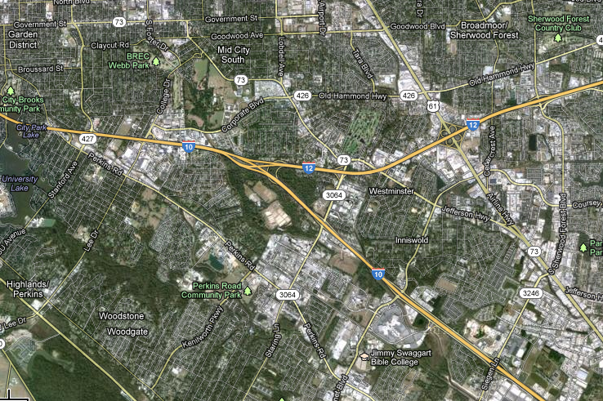
Modeling Crashes

Slide 41

Probabilities
An officer is on patrol at night. We know that half of the fatal crashes after midnight are alcohol related. The officer worked 6 fatal crashes in the past six month April to September. Let
  Y=alcohol involved,
  N= no alcohol involved
Which sequence is more likely for the crashes April to September?
NNNYYY
YNNYYN
NNNNNN

Slide 42
Three Intersections of US 90

Slide 43
The Poisson Distribution
Constant rate
2. Independence
3. Small Intervals have only 0 or 1

Slide 44
The Negative Binomial Distribution
Poisson - Gamma

Slide 45
Negative Binomial Regression
SPF Function + CMFs
Full Model

Slide 46
Poisson Regression Model for the Mean
The number of crashes for a given road section is Poisson distributed
The distribution has one parameter λ which is parameterized as a log-linear model:
BEWARE OF INTERACTIONS
The vector of covariates x_{k} includes x₁= ln(AADT), road characteristics such as x₂=road width, x₃ =shoulder width, (CMFS).
Notes:
In the third interpretation of the Negative Binomial distribution, we start with the assumption that the number of crashes at a given road section “i” is Poisson distributed, with mean lambda_i times the length of the road section times the number of years of crash data. As we have noted earlier this is a reasonable assumption for a fixed road section. The parameter lambda is per unit of measurement, commonly per year and per mile. L_{i} is the length of the road section and Y identifies the number of years we are interested in computing the probability for. Note that this is just the starting point and the model is still Poisson. In a few slides we will return to describe how the third interpretation of the Negative Binomial distribution is derived from here.
We also assume that the logarithm of the lambda can be described through a function of road design features and annual average daily travel (AADT). The road design features include characteristics such as road width, shoulder width, and other features. The beta are the regression coefficients which have to be estimated using crash data.

Slide 47
Model for Average Crash Count
Linear model for the log of lambda
Product model for λ
Example: x₁= ln(ADT)
Notes:
The linear model for the log of the mean implies a product model for the mean lambda. For example, consider a simple model with AADT only. The log model would lead to the model shown in the slide. The mean is a constant times the AADT to the power of beta 1. If the coefficient beta 1 is equal to 1, the mean is proportional to ADT as shown in the figure. This equation is called the safety performance function (SPF).

Slide 48
Examples of Covariates x_{k} for Rural Road Segments (HSM)
AADT
Lane width (LW)
Shoulder width (SW)
Shoulder type
Roadside hazard rating (RHR)
Driveway density (DD)
Horizontal curvature
Vertical curvature
Centerline rumble strips
Passing lanes
Two-way left-turn lanes
Lighting
Automated speed enforcement
Grade Level
Interaction with AADT
Notes:
Note that the more general form also includes the other factors x_{k} such as road width and shoulder width etc shown in this slide.

Slide 49
Negative Binomial Derivation
To account for unexplained factors contributing to the differences in the means of road sections with identical design features and AADT an error term is added.
The distribution of crashes conditional on the regressors (x_{k}) and the heterogeneity term is still Poisson
Error accounts for unexplained variation in means
Notes:
The Poisson distribution mean, modeled by using road characteristics, AADT and number of years of crash data, will not explain all variation between the means of the road sections. Two road sections with the same length, AADT, the same design features and number of years of data still may have different means. This is due to other factors not included in the model such as the vehicle types, percentage of trucks on the road, distribution of drivers age and gender or some other unknown road characteristics. For instance the crash rates are much higher for youth drivers, hence if one road section has a higher percentage of young drivers than another the average number of crashes will be different. To account for such factors an error term is added to the equation for the mean. Note that the error is additive in the log scale but multiplicative in the count scale. That implies that the effect of any extraneous factors not in the model are amplified as the mean increases. The multiplicative nature of the model explains the fact that crash data spread more with increasing mean displaying a funnel type pattern which opens up with increasing mean.

Slide 50
A Two-Stage Process for Explaining Crash Counts
The distribution for λ
Poisson
Negative Binomial Posterior
Mean μ₁
Crash Count road section 1
Regression mean plus Gamma error
Mean μ₂
Crash Count
road section 2
Variance of Poisson
Variance of means from Gamma
Notes:
The parameterization of lamda through a regression model plus a gamma distributed error term applied to the Poisson distribution leads to a Negative Binomial distribution for the crash count for a given section of the road. Note that the mean of the distribution is given by the Poisson mean lambda, times the section length, times the number of years of data used. Lambda i is the average number of crashes per mile per year for a given road section i. However, the variance of the Negative Binomial distribution is larger than the variance of the Poisson distribution, as shown in the slide. The variance of the Negative Binomial distribution is dependent on theta. As the parameter theta goes to infinity, the Negative Binomial distribution tends toward the Poisson distribution. Note that the variance to mean ratio is constant at 1+lambda/theta and goes to 1 as theta tends to infinity. This implies that the Negative Binomial distribution tends to the Poisson as theta increases. Since in the Poisson distribution the mean is equal to the variance, while the Negative Binomial distribution has variance that is larger than the mean, this parameter theta is also called the overdispersion parameter.

Slide 51
Example:
HSM SPF for Rural Two-way Roadway Segments
Roadway Segment Base Condition
Symbol | Description
N_{SPF} | Predicted total number of crashes per year
L | Length of roadway segment in miles
AADT | Average annual daily traffic volume
Notes:
The Highway Safety Manual lists a Safety Performance Function for the base condition of the 14 factors previously listed in slide 12. AADT is the average daily traffic volume. L is the length of the road segment in miles.
Note that:
The function in this example is linear in AADT. However, in general, SPF functions may not be linear in AADT.
Also, the over-dispersion factor (theta) used in this lecture is the length of the road segment (L) divided by 0.236. The Highway Safety Manual provides 1 over Theta which is the inverse of the over-dispersion parameter defined in this lesson.
Since this SPF has been developed for a specific set of road segments outside Louisiana it may not be valid for rural two-way road segments in Louisiana. Under the assumption that the SPF for rural two-way road segments in Louisiana is linear in AADT and the over-dispersion factor is the same as provided in the handbook the SPF for Louisiana can be simply calibrated by adjusting the constant exp(-0.312). This can be done by multiplying N_spf, i.e. the crash counts given by the SPF function, with a calibration factor that will be discussed later.
Next we will discuss how to predict crash numbers for non-base conditions.

Slide 52
Predicted Number of Crashes
Is there a problem with this?
Symbol | Description
N_{predicted} | Predicted average crash frequency for a specific year of site type x
N_{SPFx} | Predicted average crash frequency determined for base conditions of the SPF developed for site type x
CMF_{yx} | Crash Modification Factors specific to SPF for site type x
C_{x} | Calibration factor to adjust SPF for local conditions for site type x
Notes:
The predicted number of crashes is obtained by adjusting the Safety Performance Function derived by base conditions by multiplying two factors:
The crash modification factors (CMF) provided by the Highway Safety Manual for any non-base conditions
And the Calibration Factor (C)
The CMF term can also include another common adjustment factor used by many transportation agencies, called the crash reduction factor (or CRF). While an CMF is a multiplicative factor that can be less than 1.0 (representing an expected reduction in crashes) or greater than 1.0 (representing an expected increase in crashes), the CRF is the percentage crash reduction that may be expected after implementing a given countermeasure. These two values are directly related. For example, if a specific CRF had a value of 13% that indicates that deploying that countermeasure will reduce crashes by 13%. The equivalent CMF value for this condition would be CMF=1-0.13 = 0.87.
The calibration factor C is the ratio of the sum of actual number of crashes to the sum of the predicted number of crashes for all road segments for the specific site type such as rural two-way road segments.

Slide 53
What Have We Learned?
Negative Binomial Model (NBM)
  Used to estimate the SPF.
  Derived from a Poisson with Gamma Prior Distribution of the mean.
The SPF describes the relationship between average number of crashes and AADT.
The predicted number of crashes depends on AADT and road characteristics.
The crash modification factors (CMF) account for the dependency of crash number on the road characteristic.
But beware of multiplying CMFs!
Notes:
The Negative Binomial Model (NBM) is used to estimate the SPF either through the use of calibration of the safety performance function from the highway safety manual or through maximum likelihood estimation. The NBM is derived from a Poisson with Gama Prior Distribution of the mean. Through this model, each road segment is allowed to have a Poisson distribution for the crash count but with different means from section to section. The safety performance function describes the relationship between average number of crashes and AADT. The predicted number of crashes however depends not only on AADT but the road characteristics as well. The crash modification factors (CMF) account for the dependency of the crash count on the road characteristic.
The confidence intervals about the safety performance function depend on AADT, the road characteristics, the over-dispersion factor, the section length and the number of years of data. The distance of observed crash count per mile to the safety performance function cannot be used to determine if a road segment has an unusually high number of crashes because the distribution is dependent on the factors mentioned above. We will come back to this in a later lesson.

Slide 54
What Have We Learned?
The intervals for crash counts around the SPF depend on AADT, road characteristic, over-dispersion factor and section length.
The distance of observed crash count per mile to SPF cannot be used to determine if a section has unusually high number of crashes.

Slide 55

Regression to the Mean

Slide 56
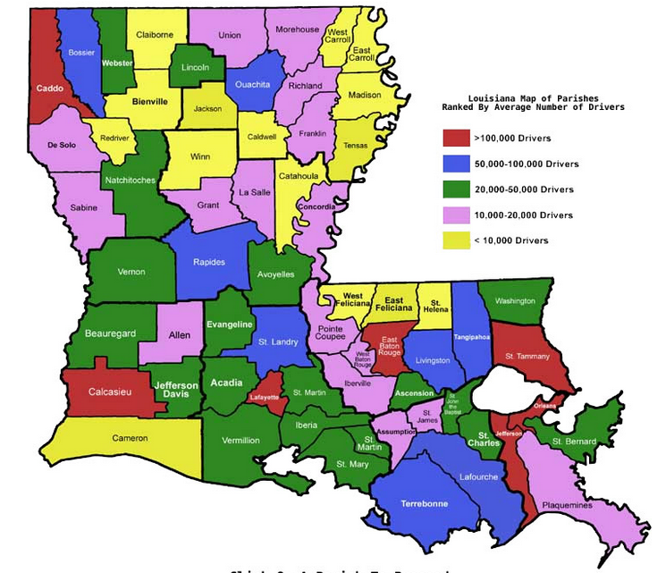
Predict Fatal Crashes for 2011
PARISH | 2010 | 2011
BIENVILLE | 11
CALDWELL | 1
CAMERON | 1
CATAHOULA | 3
CLAIBORNE | 5
LASALLE | 5
MADISON | 9
RED RIVER | 10
ST. HELENA | 4
WEST CARROLL | 4
WEST FELICIANA | 1
WINN | 3
AVERAGE | 4.8 | 3.2 | -33%

Slide 57
Fatal Crashes 2011
PARISH | 2010 | 2011
BIENVILLE | 11 | 3 | -73%
CALDWELL | 1 | 7 | 600%
CAMERON | 1 | 1 | 0%
CATAHOULA | 3 | 0 | -100%
CLAIBORNE | 5 | 3 | -40%
LASALLE | 5 | 4 | -20%
MADISON | 9 | 4 | -56%
RED RIVER | 10 | 2 | -80%
ST. HELENA | 4 | 4 | 0%
WEST CARROLL | 4 | 7 | 75%
WEST FELICIANA | 1 | 1 | 0%
WINN | 3 | 2 | -33%
AVERAGE | 4.8 | 3.2 | -33%

Slide 58




Empirical Bayes
What is it?
Why using it?
The Baysian and the Frequentist
Notes:
The Baysian is a person who sees a tail of horse or a donkey and decides it is a mule.

Slide 59
Empirical Bayes for Completely Randomized Design
Treatment | Observations | Mean
1 | y₁₁, y₁₂, …y_{1n}
2 | y₂₁, y₂₂, …y_{2n}
3 | y₃₁, y₃₂, …y_{3n}
4 | y₄₁, y₄₂, …y_{4n}
Notes:
We return to the completely randomized design discussed in an earlier chapter in order to show how the Bayes principle is used to obtain improved estimates. We assume that each of the four treatments for the tires types refers to a different month of tire production. So let’s assume the first treatment refers to a sample of tires from the January production, the second treatment is a sample from the March production, the third is from the August production and the fourth is from the December production. During the rest of the year a different tire type is produced that will not be studied here. For each of the four months of production the company has to set up the machinery anew and thus wants to make sure that the average wear for 20,000 miles driven is the same. Ideally they should be the same, but slightly different setup conditions may cause a variation in the production process. If we know that the variation in the mean for each month is described by a normal distribution with mean 12 and standard deviation 1.5, we can go ahead and calculate the Bayes estimate. If these values are unknown they must be derived from the current data before the empirical Bayes estimate can be calculated. Since the process for calculating the Bayes estimate and the empirical Bayes estimate is the same once the overall mean and variance are known, we will only work out the example for the empirical Bayes in the following slides.
We assume the sample means are generated by a process from a normal distribution. Each treatment sample has a different mean (xbar_1 to xbar_4) but a common standard deviation, sigma, which is called the “within variation” and is due to randomness of the production process within each month. Note that this variation is assumed to be the same within each month. This implies that only the mean is affected by the setup of the machinery. The objective is to estimate the individual means xbar_1 to xbar_4. We will do this by using the sample average of the observations within each sample.

Slide 60
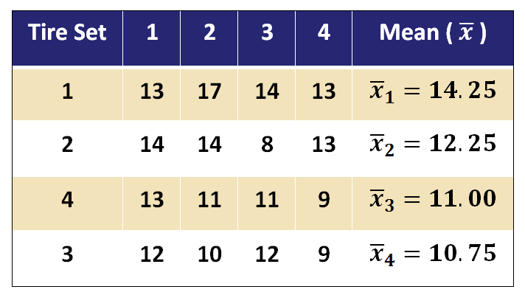
The Data: Estimate Overall Mean
From Our Previous Example
Notes:
Here are the data that were collected. Included is a mean column that contains the calculated averages for each sample. These values are necessary for calculating both a Bayes estimate and an empirical Bayes estimate.
In order to use empirical Bayes, we need to come up with an estimate from the data for the overall average, mu. For our purposes, we will use a simple average of the 4 sample means, xbar_one through xbar_four. The result of 12.0625 will be rounded to 12.1 here for convenience.
Now we can plug 12.1 into our Bayes Estimate formula.
Next we need to calculate the weight, omega. Since we already calculated the variances using an ANOVA table in lesson 2, let’s use those values for convenience.

Slide 61
Back to the ANOVA Table
(to get variances)
Source of Variation | SUM of Squares | Degrees of Freedom | Mean Square | F
Treatment | 30.6 | 3 | 10.2 | 2.43
Error | 50.3 | 12 | 4.2
Total | 80.9 | 15
Notes:
The variance of the distributions for the means (or zeta squared), is obtained from the mean squared error, in this case 10.2.
The mean squared error of 4.2 is an estimate of the within treatment variance, sigma squared.
Our number of samples is 4.
Plug these values into the formula for omega and we obtain a result of omega=0.093.
Now we are ready to compute the empirical Bayes estimate for each of the samples. The estimate for the first sample is shown in the next slide.

Slide 62
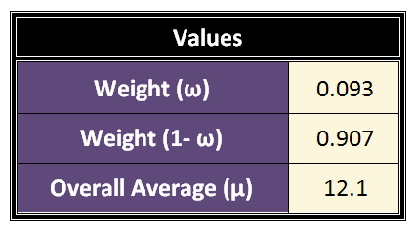
The Data: Calculation for Tire Set
Tire Set | Tire 2 | EB
1 | 17 | 14.05
2 | 14 | 12.24
4 | 11 | 10.88
3 | 10 | 11.10
Notes:
Using the formula from the previous slide, the only value left to input is the sample mean. For tire set 1 this value is 14.25. The computation shown on screen yields a result of 14.05. The same calculation can be applied to each of the remaining tire sets.
Note that the omega is rather small because of the sample size of 4 and therefore the Bayes estimates are not much different from the sample means. To better demonstrate the power of sample size on omega, let’s reduce the sample size. Instead of looking at all four tires, let’s look only one tire for each of the samples.

Slide 63
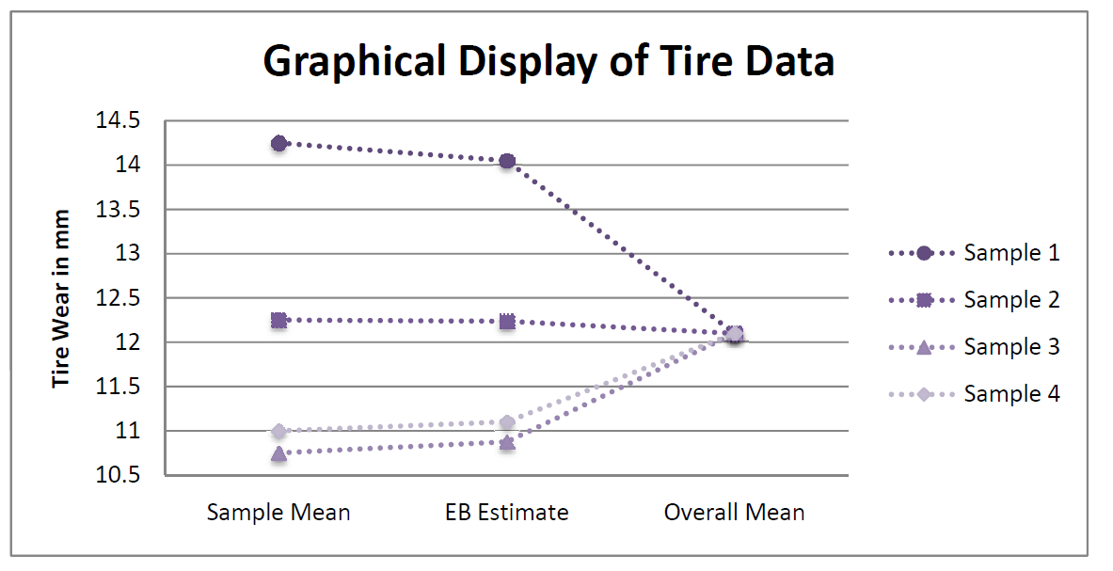
Graphical Display of EB
Sample Results
Notes:
To illustrate intuitively how the empirical Bayes estimator addressed regression to the mean problems, consider this graph. It shows three different estimates of tire wear in millimeters of four different tire samples: the sample mean, the empirical Bayes estimate and the overall mean. From the graph it is easy to see that the empirical Bayes estimate is in between the sample mean and the overall mean. This will always be the case because the empirical Bayes estimate is a weighted average of both the individual sample mean and the overall mean. By moving the estimate closer to mean, the empirical Bayes estimator accounts for the fact that an extreme observation of a random variable is likely to be observed closer to the mean of its generating process in following periods. Therefore Empirical Bayes estimators produce a more accurate estimate than either the sample mean or overall mean taken alone.

Slide 64
Using Bayes
Pros
Cons
Hedges against regression to the mean
Provides compromise versus hypothesis testing
Complicated
Not accepted by many statisticians (FDA)

Slide 65
Hypothesis Testing and Empirical Bayes
Top p%
Lp
N Observed
Notes:
As mentioned earlier many researchers found that the empirical Bayes (EB) estimate for the true mean number of crashes of a road section is superior to using the simple average when deciding whether a mean belongs to the class of top-p%. This is not surprising because it is not a fair comparison. One should compare the EB estimate with the hypothesis test not the point estimate. In fact, the Empirical Bayes estimate can be written in form of the classical test statistic shown on the slide. In classical statistical testing when the test statistic T exceeds a critical value, we reject the null hypothesis. The Bayesian approach does not make this decision. It rather opts for something in-between as can be seen from the formula.
In summary, the observed average is not a sufficient measure for deciding on whether or not a the true average belongs to the top p% or not. The classical correct method is that of a statistical test. There is no inherent superiority of the empirical Bayes estimate compared to classical statistics when using it for selecting the top-p% of crash locations. Either the EB or the classical testing may be used and will have the same long-run result. Both methods take into account the variation of the observed average.
However, as mentioned earlier, both methods assume that there is no trend in the data.

Slide 66
“Double-Blind” Analysis of top-p% Locations
Low crash count
Top p%
Lp
Notes:
There is an inherent bias in selecting the top p% of locations and analyzing them. Any analysis is likely to find some deficiency used to explain the high crash numbers. But this does not amount to discovering a cause. Recall the requirements of a double blind study to avoid investigator bias. Thus how do we mimic the double blind studies when analyzing the top-p% crash locations? Elvik suggests to compare high crash locations with the low crash locations for the same ADT and geometric features to get a clue about the causes. In order to avoid investigator bias he suggests to submit high and low crash locations to investigators without telling them which is high and which is low. This is similar to the double blind studies.

Slide 67
Considerations for Black Spots Location Analysis
Statistics can only rank crash locations - not determine black spots.
Why do we need models? Why not just rank segments by crash count. So that we compare apples to apples!
But what CMFs should be included in the predictive model.
    All of them? Should roadside hazard rating be included?
    Some of them? Which CMF?
    Only AADT?
Select p% of highest crash locations to be investigated. To do this you need
  Variation measure: (1, 10, 4) and (5,5,5) are not the same.
  Length of road segment: 5 crashes per mile have different standard deviations for a 2-mile segment an a 0.2 mile segment
Use statistical test or EB to account for within sample variation.
Notes:
The procedure for determining the top p% of locations that warrant further analysis can be summarized as follows:
First, use a NB regression model with the crash modification factors to determine the expected crash frequency (Npredict) for a given road segment. Sometimes investigators tend to combine road segments to decrease the variation in crash counts. But this method defeats the purpose of identifying potential locations with a high frequency of crashes. If road sections are combined the effect of averaging may mask the high crash location.
Second, select a percentage p of highest crash locations to be investigated based on the available resources. If all location above average are selected than this would amount to selecting about 50% of all crash locations. It is unlikely that any DOT has the resources to analyze 50% of all locations. In most cases a p of 5% to 10% may be manageable. Third, for all locations compute Lp based on the distribution from the NB model for given ADT and geometric features. Note that Lp will vary with section length and all the covariates in the model. Fourth, obtain observed average crash frequency for each location for 3 to 5 years. We should be aware that the more years we choose the more likely it is that a trend in the crash counts is present which violates the model assumptions. This implies that not the simple average nor the EB average will be a good estimate of the current true mean crash count.
Fifth, use either the EB or a statistical test to select the top p% above Lp. Sixth, obtain top p% locations for all road segments. Seventh, analyze the top p% locations by paring them with similar locations but lower crash counts in a blind study.

Slide 68

The Monty Hall Problem in Let’s Make A Deal
You are a contestant in a game show in which a car is hidden behind one of three curtains. you will win the car if you select the correct curtain. After you have picked one curtain but before the curtain is lifted, the emcee lifts one of the other curtains, revealing an empty stage, and asks if you would like to switch from your current selection to the remaining curtain.

Slide 69

Let’s Make A Deal
Your choice

Slide 70


Do you Switch Curtains?
Your choice
Curtain lifted - No Car

Slide 71

Do you Switch Curtains?
Your choice?
Empty Curtain

