Slide 1

Louisiana Traffic Records Data Report 2010
lhsc.lsu.edu
Lacrashdata.lsu.edu
Presented by Dr. Helmut Schneider

Slide 2
Contributions to Crashes and Severity
Crashes & Severity
Vehicle
Roads
People
About 90%

Slide 3
Fatalities and Fatal Crashes have declined significantly in 2010 for the Third year in a row

Slide 4
Injuries

Slide 5
Fatal Crash Rate of Youths Drivers Declined

Slide 6
What are the Major Contributors to Fatal Crashes
Fatalities
Alcohol
Lack of Seatbelt Use
Aggress. Driving
About one out of two
About two out
of three

Slide 7
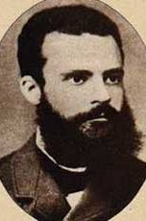
Pareto: The 20-80 Rule
Over 81% of driver fatalities involved one of these three factors of the driver killed.
Lack of Seatbelt Use
Aggressive
Driving
Alcohol
53%
69%
72%
20%
51%
46%
70%
Notes:
driver 378 alcohol 187- 49%
no seatbelt 222- 59%
Aggress dr 204 -54%
any of three 323- 85%
all three 82- 22%
--all drivers
select count(*) as any three
from vehic_tb
where veh_type_cd in ('a','b','c','d')
and dr_inj_cd='a'
--alcohol
select count(*) as alcohol
from vehic_tb
where veh_type_cd in ('a','b','c','d')
and dr_inj_cd='a'
and vehic_tb.est_alcohol='1'
--seatbelt
select count(*) as seatbelt
from vehic_tb
where veh_type_cd in ('a','b','c','d')
and dr_inj_cd='a'
and DR_PROTSYS_CD ='a'
---aggressive dr
select count(*) as aggressive
from vehic_tb
where veh_type_cd in ('a','b','c','d')
and dr_inj_cd='a'
and VIOLATIONS_CD IN ('S','C','L','D','B','A','F')
---alco&seatbelt
select count(*) as alc_seatb
from vehic_tb
where veh_type_cd in ('a','b','c','d')
and dr_inj_cd='a'
and (vehic_tb.est_alcohol='1'
or DR_PROTSYS_CD ='a' )
---all alc_viol
select count(*) as alc_viol
from vehic_tb
where veh_type_cd in ('a','b','c','d')
and dr_inj_cd='a'
and (vehic_tb.est_alcohol='1'
or VIOLATIONS_CD IN ('S','C','L','D','B','A','F'))
---all seatb_viol
select count(*) as sb_viol
from vehic_tb
where veh_type_cd in ('a','b','c','d')
and dr_inj_cd='a'
and (DR_PROTSYS_CD ='a'
or VIOLATIONS_CD IN ('S','C','L','D','B','A','F'))
---all three
select count(*) as allthree
from vehic_tb
where veh_type_cd in ('a','b','c','d')
and dr_inj_cd='a'
and (vehic_tb.est_alcohol='1'
and DR_PROTSYS_CD ='a'
and VIOLATIONS_CD IN ('S','C','L','D','B','A','F'))
---any three
select count(*) as anythree
from vehic_tb
where veh_type_cd in ('a','b','c','d')
and dr_inj_cd='a'
and (vehic_tb.est_alcohol='1'
or DR_PROTSYS_CD ='a'
or VIOLATIONS_CD IN ('S','C','L','D','B','A','F'))

Slide 8
Percent Alcohol Related Fatalities
Lowest ever, except the Katrina Year

Slide 9
Fatal Crash Rate of Youths Drivers In Alcohol Crashes Declined

Slide 10
2010 - DWI Arrests

Slide 11
Percent of DWI 1st+ Convictions on DWI Arrests
Notes:
Does not show 894

Slide 12
Repeat Offenders
There is the common believe that repeat offenders are the problem. However,
90 to 95% of impaired drivers in fatal crashes were without an DUI arrest in the prior three years.
It takes on the average 27 thousand miles of impaired driving before being arrested.
If we put every repeat offender in prison for life we would have eliminated only 5% to 10% of the problem.
Notes:
Being arrested and/or in a crash depends on a wide variety of comorbid factors.

Slide 13
DWI Arrests and DWI 1st+ Convictions
Does not show 894!

Slide 14
DWI Arrests and Interlock Devices Installed
Notes:
About 20% of arrested get an interlock. 894 and some pretrial diversion programs may avoid interlock

Slide 15
Arrests and DWI 1st+ Convictions 2009

Slide 16
Interlock Issues
Drivers who take advantage of 894 may avoid installing interlock devices.
Drivers who take advantage of PTD programs may avoid installing interlock devices.
Drivers with administrative license suspension may still drive.
Multiple arrested drivers may avoid convictions for various reasons.

Slide 17
Seat Belts
Observed Seat Belt Usage
Usage In Fatal Crashes
}
24%
59%

Slide 18
Percentage of those killed not wearing a seat belt
The law change has not much an effect on back-seat fatalities.
85%,
88% in 2009
73% in 2009
56%,
63% in 2009
57%,

Slide 19
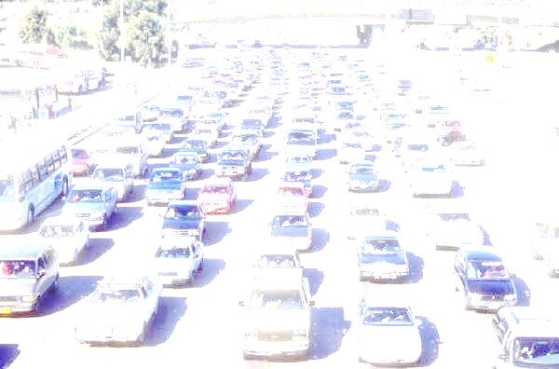
Interstate Fatalities

Slide 20
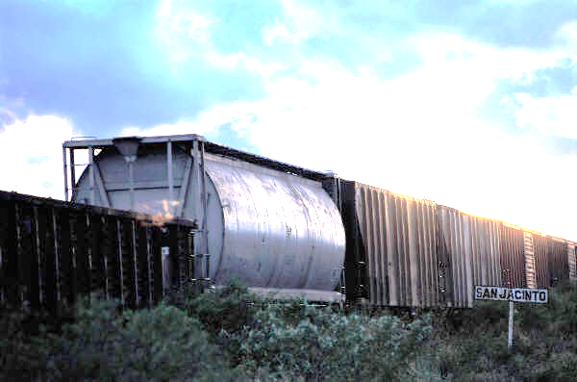
Train Fatalities

Slide 21
Pedestrians and Bicycles
Pedestrian Fatalities
Bicycle Fatalities
Notes:
Alcohol involvement is a factor for both. About one third of the pedestrians had been drinking and about half of the bicyclists had been drinking.

Slide 22
Motorcycle Crashes
Motorcycle Fatalities
Motorcycles in Crashes

Slide 23
Rider Fatalities per 100 Drivers in Crashes
4.3
3.8

Slide 24
Commercial Vehicle Crashes
Fatal
All

Slide 25
Cost of Crashes without Pain and Suffering
 | Average Cost per Person | Per crash | Alcohol | Seat Belt | Change from 2009
Fatal | $1,241,054 | $1,607,355 | $366,110,977 | $383,485,735 | -$112,193,055
All Injuries | $71,572 | $82,313 | $571,028,427 | $573,161,261 | -$248,038,316
PDO | $3,216 | $6,063 | $26,551,539 | $32,227,144 | -$10,816,530
Total Cost | $5,321,788,103 |  | $963,690,944 | $988,874,140 | -$371,047,901
Cost per lic | $1,855 |  |  |  | -$136

Slide 26
Crash Clock
Was 8 in 2007
Fatalities Occur Every
Hours | Minutes | Seconds
12 | 26 | 30
Injuries Occur Every
Hours | Minutes | Seconds
0 | 7 | 39
Property Damage Only Crashes Occur Every
Hours | Minutes | Seconds
0 | 5 | 0
Crashes Occur Every
Hours | Minutes | Seconds
0 | 3 | 33
Table A23: Crash Clock

Slide 27
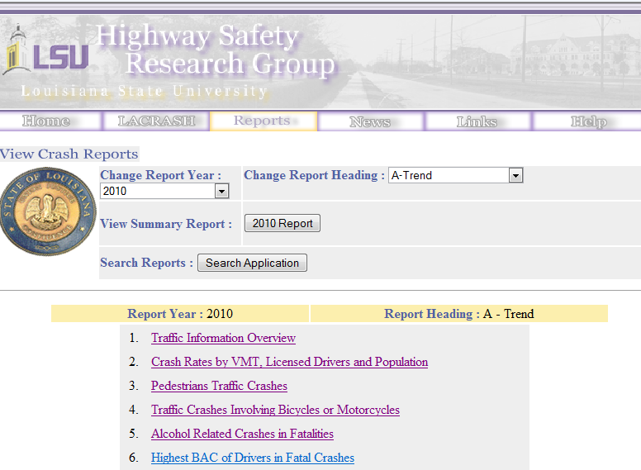
http://lhsc.lsu.edu

Slide 28
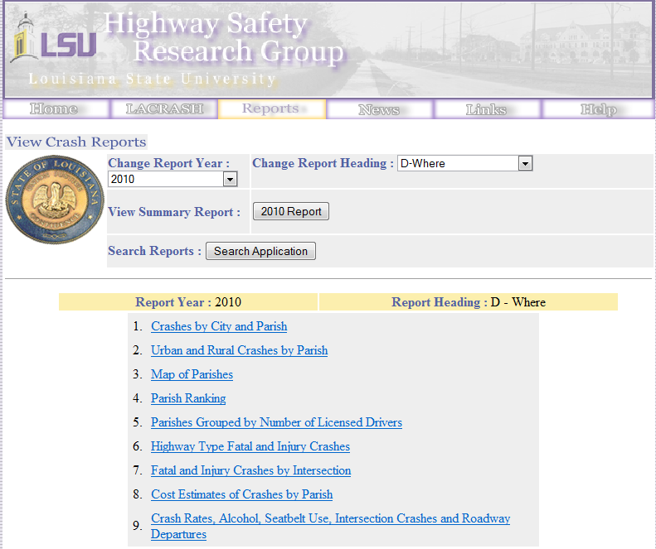

Slide 29
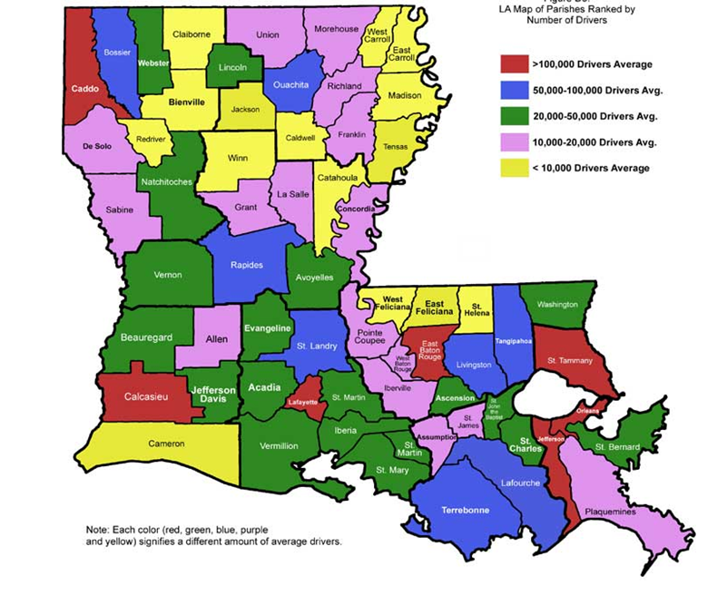
Section D3

Slide 30
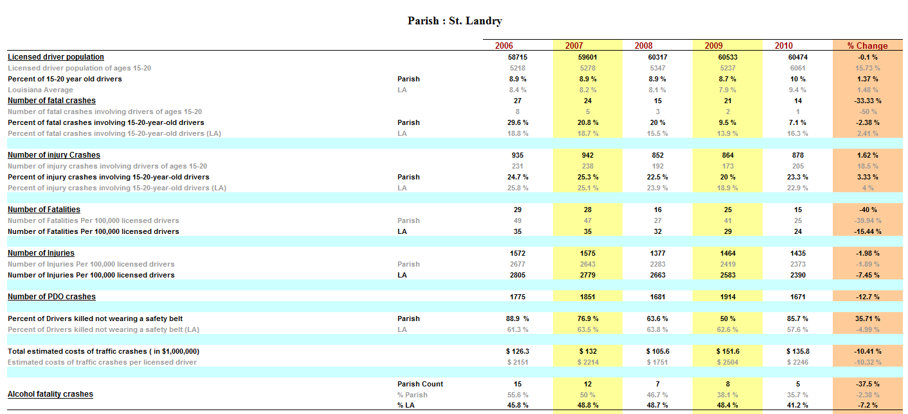
Click on Parish

Slide 31
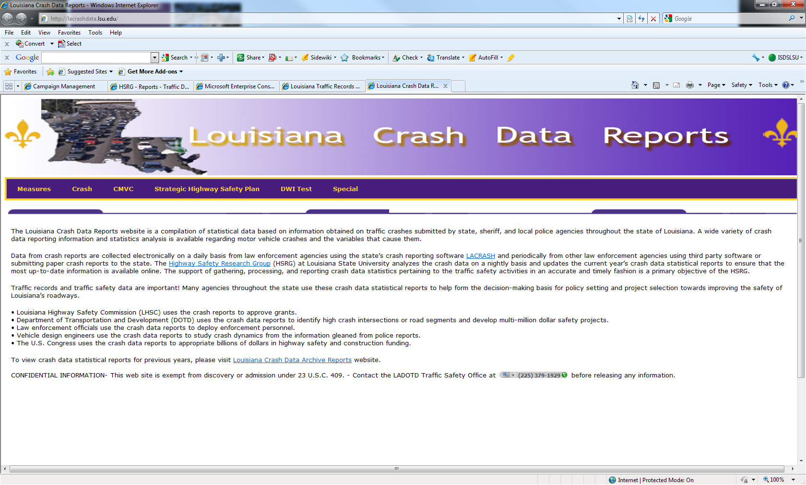
http://lacrashdata.lsu.edu/

