Slide 1

Louisiana Traffic Records Data Report 2012
hsrg.lsu.edu
datareports.lsu.edu
Presented by Dr. Helmut Schneider

Slide 2
Fatalities and Fatal Crashes show an increase for 2012 after experiencing a 4 year decline

Slide 3

1 death per 2,607 times around the world
What are the Reasons for the Increase?

Slide 4
Part of the Story….
Unemployment
Fatalities
Unemployment rescaled for comparison

Slide 5
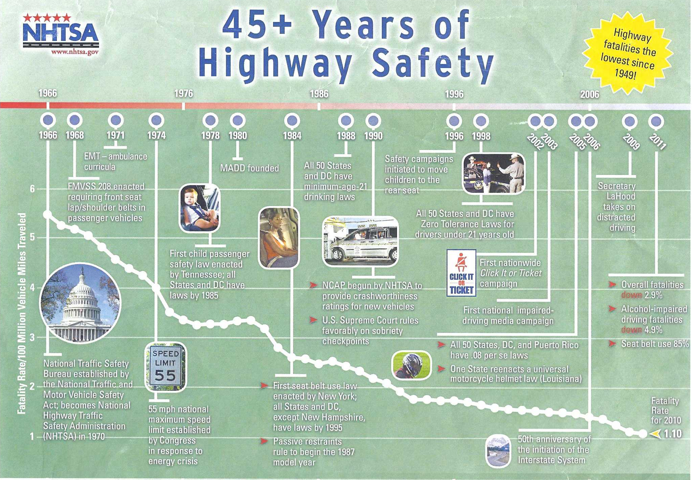

Slide 6
The Good News:
Driver Fatalities are Down

Slide 7
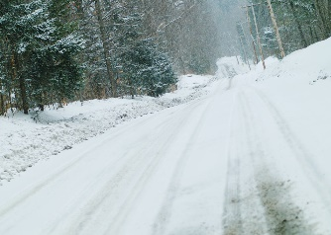
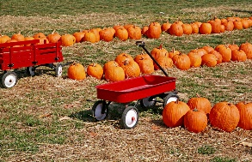
Fatal Crashes by Quarter 2007-2013

Slide 8
Fatalities By Troop Area
Troop Area | Number of Fatalities | Diff Fatal Crashes 2012-2011
A (EBR) | 152 | 40
B (NO) | 87 | 18
C (Houma) | 42 | 3
D (Lake Charles) | 52 | 13
E (Alexandria) | 87 | (1)
F (Monroe) | 49 | (24)
G (Shreveport) | 70 | (4)
I (Lafayette) | 110 | (9)
L (Hammond) | 73 | 10

Slide 9
133 166 involved
20 52 79 killed
Fatal Crash Rate of Youth Drivers
71 93
16 29 39

Slide 10
The Bad News: Pedestrian Fatalities
Notes:
2013 fatalities are down so far (97 September 2012-2013)

Slide 11
Pedestrian Fatalities by Parish
Parish | 2008 | 2009 | 2010 | 2011 | 2012
Jefferson | 10 | 11 | 3 | 1 | 14
East Baton Rouge | 8 | 9 | 13 | 10 | 11
Calcasieu | 3 | 9 | 6 | 2 | 8
Orleans | 12 | 15 | 1 | 8 | 7
St. Landry | 1 | 1 | 1 | 4 | 6
Caddo | 4 | 3 | 4 | 6 | 5
Livingston | 2 | 2 |  | 1 | 5
Rapides | 5 | 3 | 3 | 6 | 5
West Baton Rouge | 1 | 2 | 1 |  | 5
Lafayette | 7 | 7 | 4 | 5 | 4

Slide 12
Pedestrian Fatalities by Time of Day
Crash Hours | 2008 | 2009 | 2010 | 2011 | 2012
Midnight-6am | 32 | 35 | 27 | 19 | 34
6am-noon | 13 | 11 | 10 | 12 | 12
Noon-6pm | 16 | 14 | 9 | 11 | 13
6pm-midnight | 49 | 49 | 33 | 51 | 62

Slide 13
Bicycle Fatalities

Slide 14
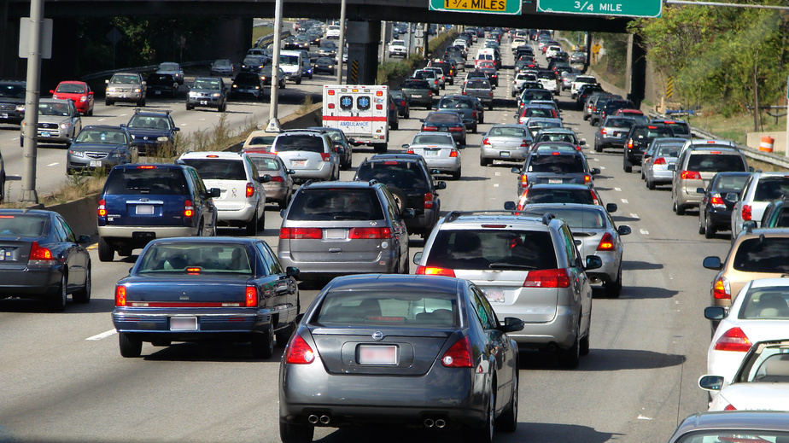
Interstate Fatalities
Notes:
2013 interstate fatalities are up 2013 crashes 98 fatalities 113

Slide 15

Cell Phone in Crashes

Slide 16
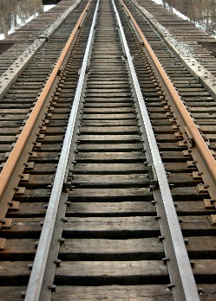
Other Trends
Trains:
  fatalities 4 (-3 from 2011)
Motorcycle:
  fatalities 78 (-1 from 2011)

Slide 17
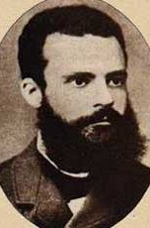
Pareto: The 80-20 Rule
Over 79% (84%) of driver fatalities involved one of these three factors of the driver killed.
Lack of Seatbelt Use
Aggressive
Driving
Alcohol
51%(61%)
70%
64%
16%
49%(55%)
38%(43%)
Includes only cars, PKUP, SUV and Vans. 2011 values in parentheses.
68%

Slide 18
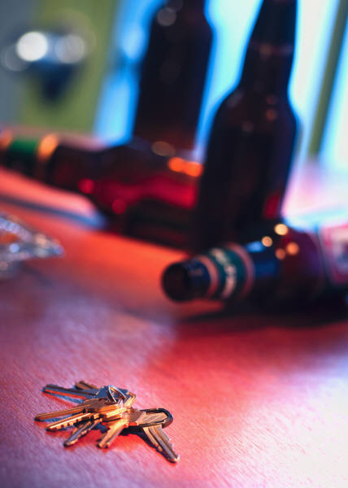

Slide 19
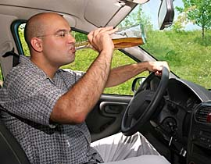
Fatal Crash Rate of Youths Drivers In Alcohol Crashes

Slide 20
Alcohol Related Fatal Crashes Ages 18-20
 | Per 100,000 licensed Drivers | Account for Drivers in Fatal Alcohol-Related Crashes | % of drivers in this age group with Alcohol
2007 | 29.4 | 10.7% | 32.3%
2012 | 10.0 | 5.5% | 19.7%

Slide 21
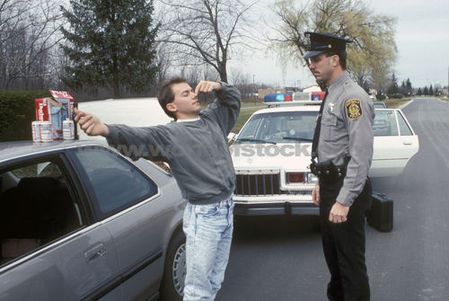

Slide 22
Alcohol Fatal Crashes by Troop Area
Troop | Non-Alcohol | Alcohol Involved | Number of Fatal Crashes | % Alcohol-Related Fatal Crashes | Diff Fatal Crashes 2012-2011 | Diff Alcohol Fat. Crashes 2012-2011
A (EBR) | 82 | 70 | 152 | 46% | 40 | 23
B (NO) | 43 | 44 | 87 | 51% | 18 | 10
C (Houma) | 22 | 20 | 42 | 48% | 3 | -
D (Lake Charles) | 33 | 19 | 52 | 37% | 13 | (2)
E (Alexandria) | 56 | 31 | 87 | 36% | (1) | (3)
F (Monroe) | 33 | 16 | 49 | 33% | (24) | (2)
G (Shreveport) | 55 | 15 | 70 | 21% | (4) | (8)
I (Lafayette) | 54 | 56 | 110 | 51% | (9) | (3)
L (Hammond) | 47 | 26 | 73 | 36% | 10 | 5

Slide 23
DWI Arrest by Troop 2012
Bubble Size is Number of Licensed Drivers

Slide 24
Alcohol-Related Fatalities by Troop Area 2012
Bubble Size is Number of Fatal Crashes

Slide 25
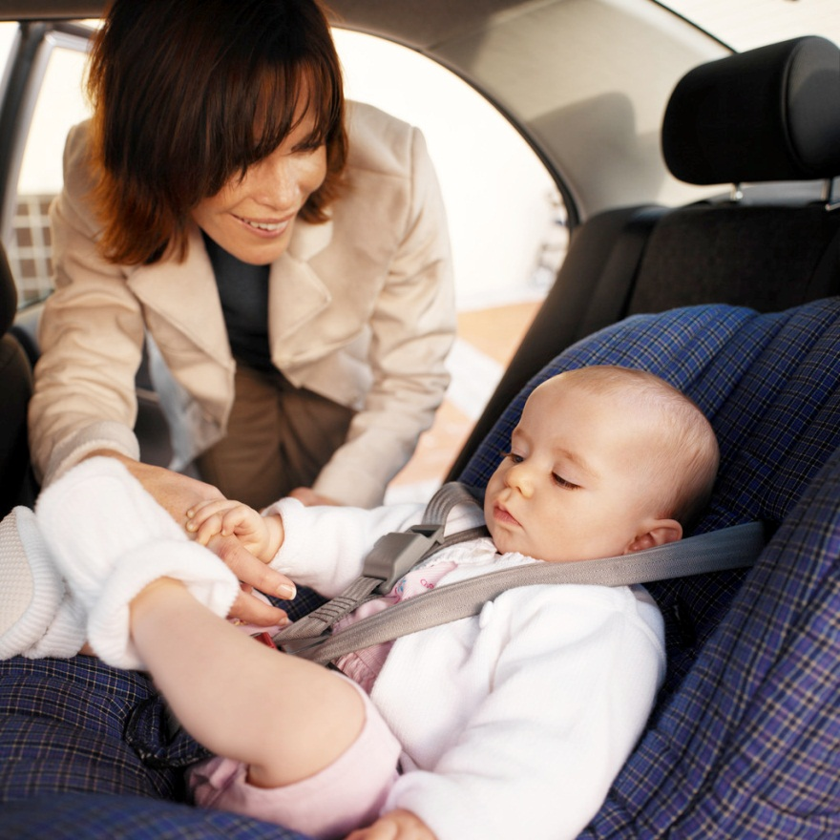
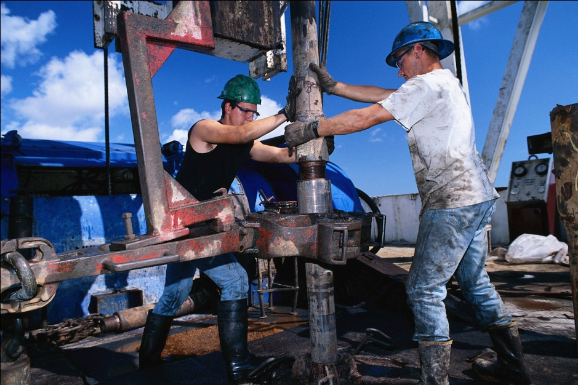
Safety

Slide 26
About 20% of the drivers not wearing a seat belt
make up about 60% of fatalities!

Slide 27
Region | %AUTO | %PKUP | %SUV | %VAN | 2012 | 2013 | Diff
1 (NO) | 77% | 75% | 82% | 82% | 81% | 78% | -3%
2 (EBR) | 87% | 73% | 85% | 93% | 74% | 83% | 9%
3 (Houma) | 90% | 76% | 89% | 78% | 80% | 86% | 5%
4 (Lafayette) | 85% | 74% | 87% | 93% | 84% | 82% | -2%
5 ( Lake Charles) | 95% | 86% | 94% | 91% | 86% | 91% | 5%
6 ( Alexandria) | 80% | 84% | 87% | 93% | 73% | 83% | 11%
7 (Shreveport) | 87% | 78% | 85% | 82% | 80% | 84% | 4%
8 (Monroe) | 80% | 73% | 90% | 92% | 63% | 81% | 19%
Louisiana Average | 84% | 76% | 86% | 86% | 79% | 83% | 3%

Slide 28
Seat Belt Usage by Region

Slide 29
Vehicle Distribution and Drivers Killed
Vehicles on the Roads
Drivers Killed

Slide 30
Seat Belt Use and Drivers Killed not Wearing Seat Belt
Percentage Seat Belt Use in Roadside Survey
Percent of Fatally Injured Drivers
Percent of Fatally Injured Drivers
Not Wearing a Seat Belt

Slide 31
Vehicle Type versus Driver Killed not wearing Seat Belt
Vehicles on Roads
Driver Fatalities No Seat Belt

Slide 34
Percent of Fatally Injured Drivers
Not Wearing a Seat Belt

Slide 36
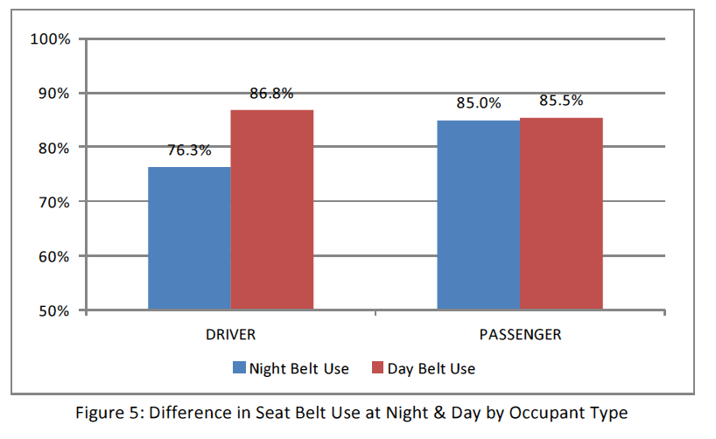
Night Versus Day-Time Seat Belt Use
Robert Chaffe
Preusser Research Group, Inc.

Slide 38
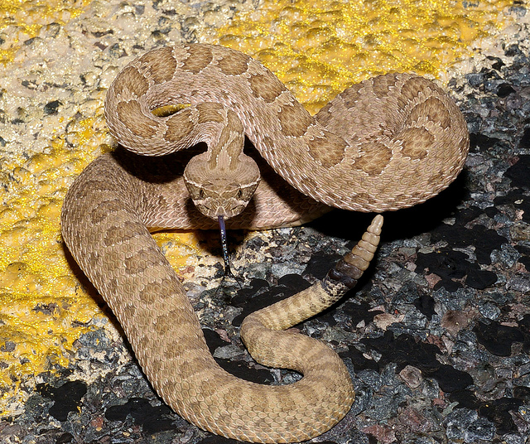
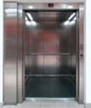
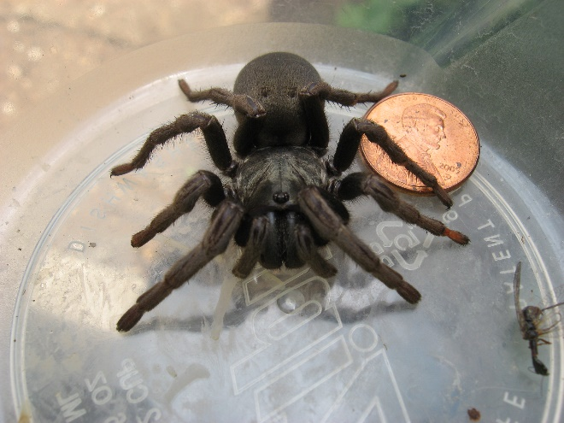
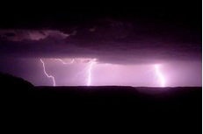
The Top 10 Fears don’t include being in a crash and getting killed not wearing a seat belt.

